Slide 1
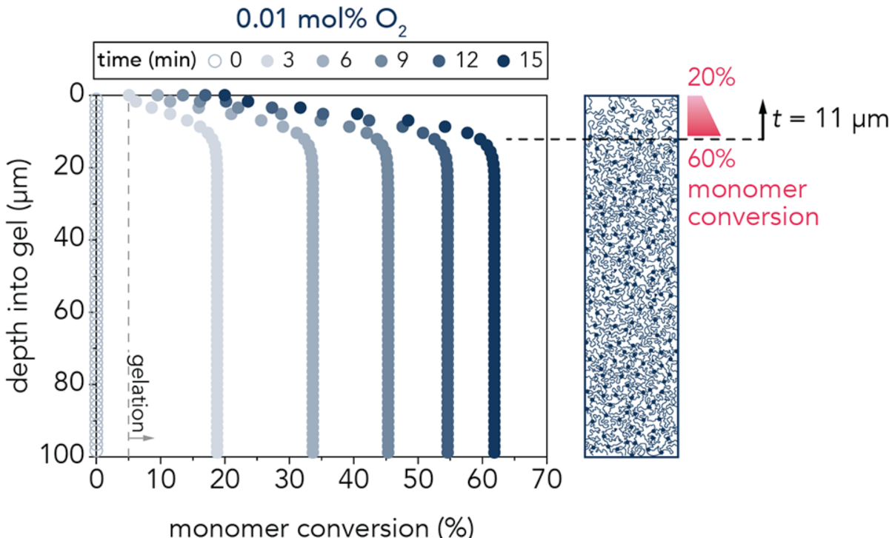
UC Santa Barbara MRSEC
DMR-2308708
Superlubricious Hydrogels from Oxidation Gradients
Matt Helgeson and Angela Pitenis (UC Santa Barbara)
Hydrogels are hydrated three-dimensional networks of hydrophilic polymers that are commonly used in the biomedical industry due to their mechanical and structural tunability, biocompatibility, and similar water content to biological tissues.
The surface structure of hydrogels polymerized through free-radical polymerization can be modified by controlling environmental oxygen concentrations, leading to the formation of a polymer concentration gradient. UC Santa Barbara MRSEC researchers created polyacrylamide hydrogels in varying oxygen environments and monitored their mechanical and tribological properties.
Without significantly reducing the elastic modulus of the hydrogel an order of magnitude reduction in the friction coefficient can be created simply by adjusting polymerization conditions (e.g. oxygen concentration).
A quantitative analytical model based on polyacrylamide chemistry and kinetics has developed.
Monomer conversion at the surface of the gel at various polymerization times as a function of depth from the gel surface.
Chau, Edwards, Helgeson, Pitenis, Designing superlubricious hydrogels from spontaneous peroxidation gradients, ACS Appl. Mater. Interfaces 15 (2023) 43075−43086. DOI: 10.1021/acsami.3c04636
Notes:
What Has Been Achieved: Please see above.
Importance of the Achievement: Polyacrylamide-based hydrogels can be created with the same overall mechanical properties but with surfaces that display significantly lower friction, simply by mild changes to the reaction conditions. This has implications for the many uses of hydrogels, for example, in contact lenses.
How is the achievement related to the IRG, and how does it help it achieve its goals? An important goal of IRG-2 is to develop more resilient and responsive gels.
Where the findings are published: Chau, Edwards, Helgeson, Pitenis, Designing superlubricious hydrogels from spontaneous peroxidation gradients, ACS Appl. Mater. Interfaces 15 (2023) 43075−43086. DOI: 10.1021/acsami.3c04636

