Slide 1
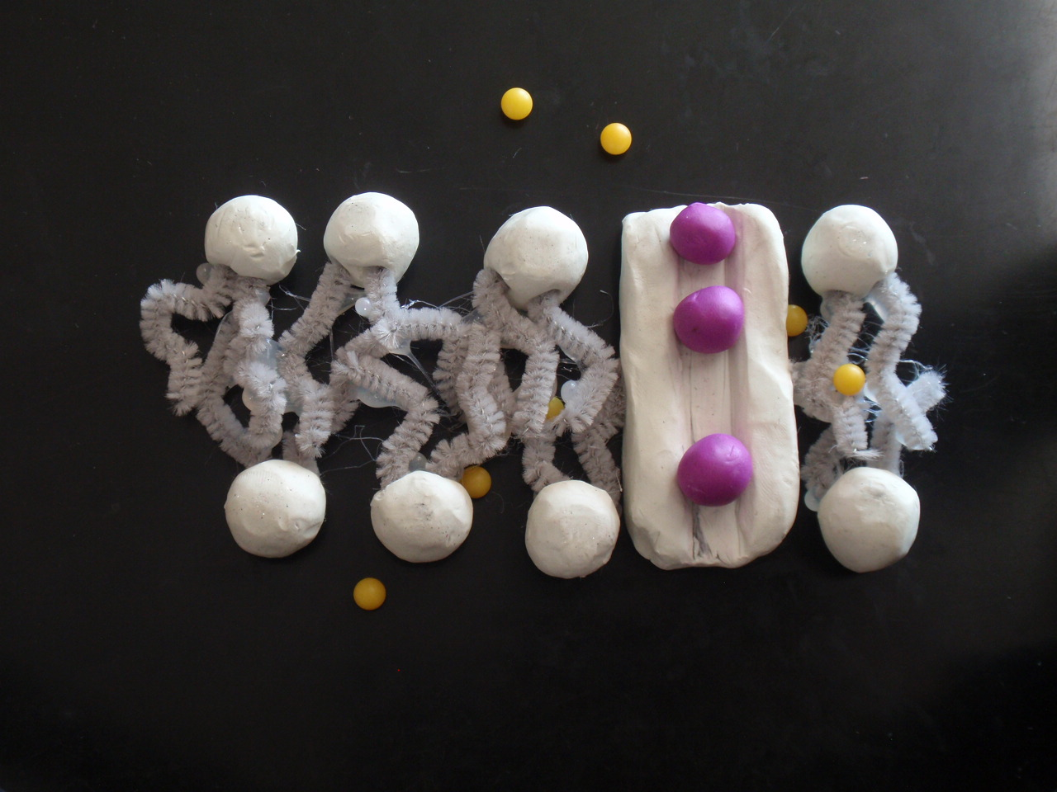
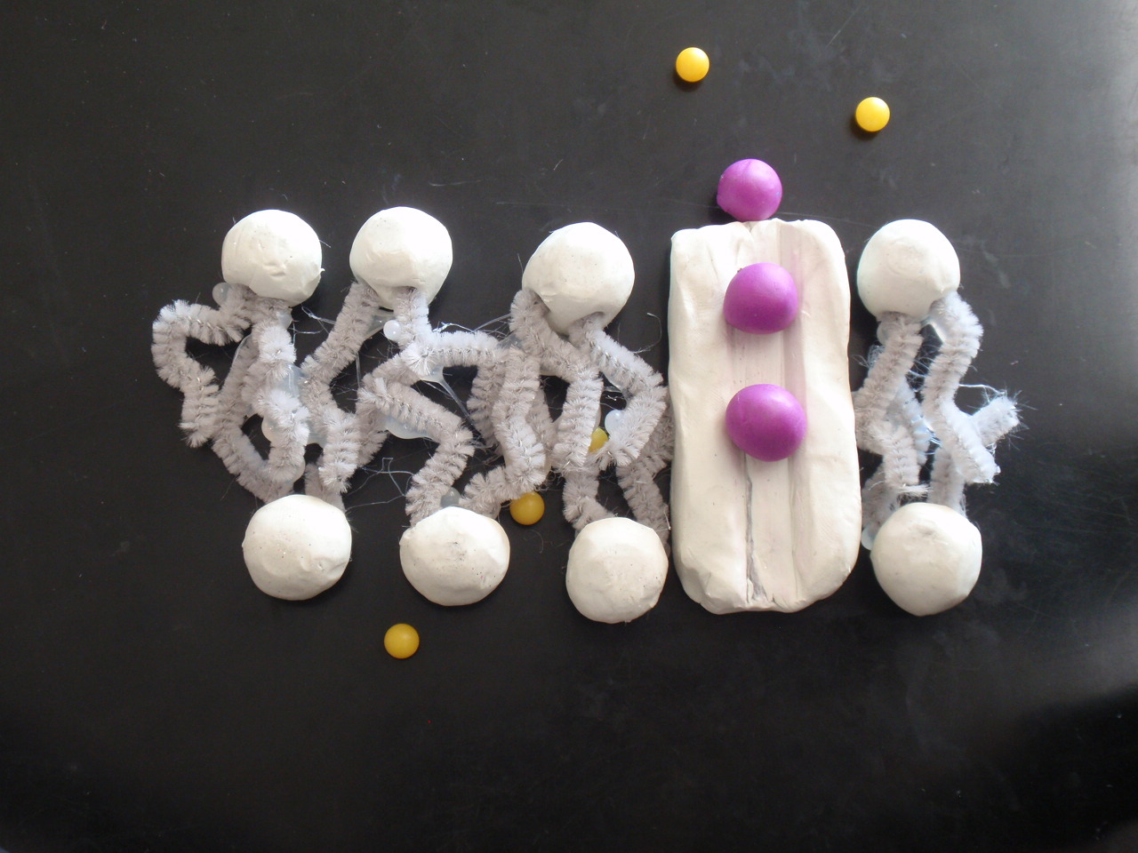
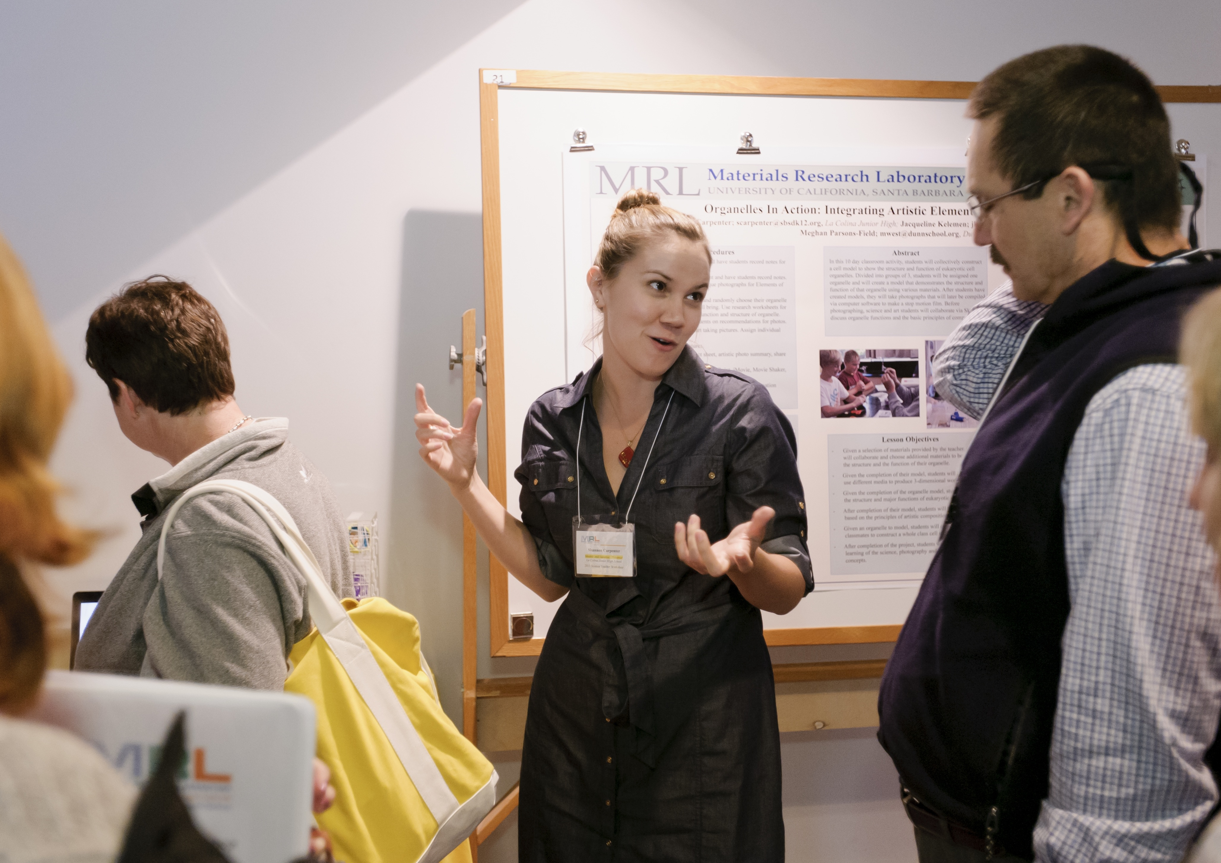
Education NSF-DMR11-21053
Teachers Merge Art and Science at the UCSB MRSEC
The UCSB Materials Research Laboratory’s “Models and Materials” Teacher Institute teamed secondary art and science teachers to develop interdisciplinary curriculum projects combining art and science with student-created models. Five science and four art teachers from Santa Barbara and Ventura County schools participated in this teacher professional development opportunity and presented their lesson plans at the MRL Secondary Curriculum Workshop in March 2013.
Teachers Merge Art and Science at the UCSB MRSEC
One of the four teams challenged middle school students to build models of organelles and use stop motion animation to demonstrate their function. In this student model molecules pass through a channel in the cell membrane.
Middle school teacher Shannon Carpenter presents the Cell Model Curriculum to colleagues at the MRL Secondary Curriculum Workshop

