Slide 1
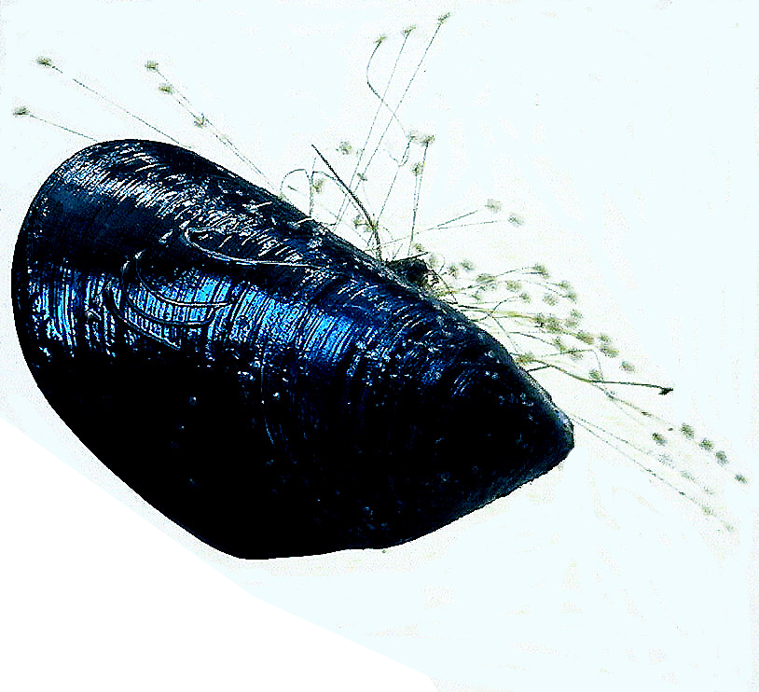
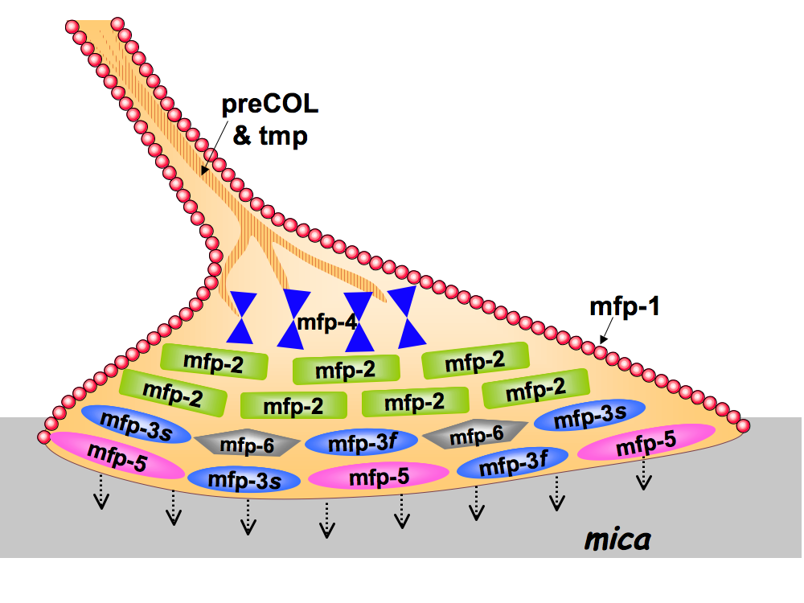
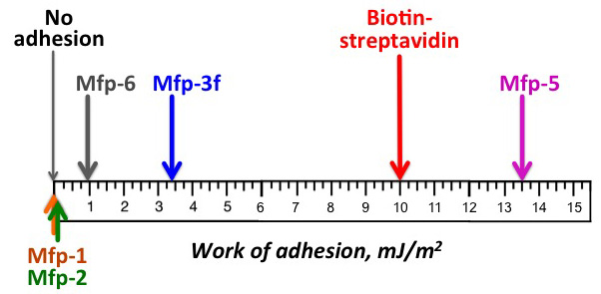
IRG-1
NSF-DMR1121053
Mussel protein adhesion to mica surpasses biotin-avidin affinity
Asymmetrical films of adhesive protein Mfp-5 show significantly higher reversible adhesion to smooth mica surfaces than the “gold standard” of noncovalent binding: well-ordered avidin-biotin interactions. The insights are crucial for intelligent translation of mussel adhesion to engineered systems.
Danner, Kan, Hammer, Israelachvili & Waite
Notes:
Adhesion conditions were pH 3, ionic strength 0.15 M at ambient temperature and pressure

