Slide 1
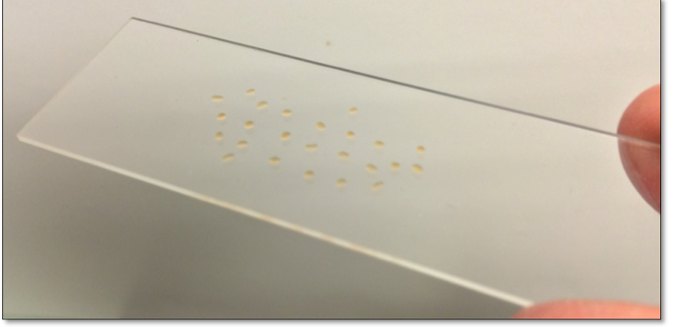
Ferronematic Fredericksz Transition LCMRC researchers are exploring the recently discovered ferronematic liquid crystal phase, revealing a dramatic polar magneto-optical response to externally applied magnetic field in millimeter-size droplets on glass slides, like the one shown. With one sign of field normal to the slide the molecules stand up also normal to the glass but for the other sign, shown in the image, the molecules flip over, a reorientation heralded by the dramatic appearance of birefringence above a threshold field. This response represents a record-large magneto-optical effect.

Slide 2
Family Science Evenings These evenings offer an opportunity for K-12 students and their parents to enter the realm of science and engineering together, such as the father and son seen here using the Center’s Exploring the Nanoworld 'nanoscale' probe. ⇨ Families interact with selected science ideas and experiments taken from refined content developed forK-12 outreach. This program, which is based on the successful existing national model of Iridescent, affords an increased social interaction within and across families, an underpinning strength that increases interest in and communication about STEM topics. .

Slide 3
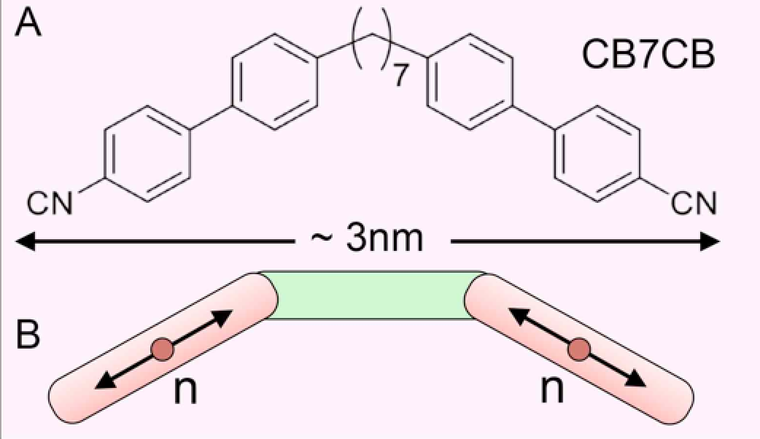
The Heliconical Nematic phase LCMRC researchers have found an extraordinary nematic liquid crystal phase, a new entry in the most widely studied and widely applied class of liquid crystals. In the whole history of liquid crystals only four distinct nematic ground states have been found: the uniaxial, the biaxial, and, for chiral molecules, the helical nematic and blue phases. The “heliconical” phase reported here is a fundamentally new type of nematic state exhibiting the first layer-free liquid crystal ordering with coherent structure on the nanoscale. Its spontaneously chiral conical helix, appearing as broken symmetry since the bent molecular dimers such as CB7CB are achiral, exhibits the amazingly short pitch of 8nm, making it the liquid crystal coherent ordering that is closest in scale to the molecular size, in this case 3nm. This discovery, as a result, promises a unique opportunity to advance liquid crystal science at the interface of molecular design and soft matter physics. .

