Slide 1
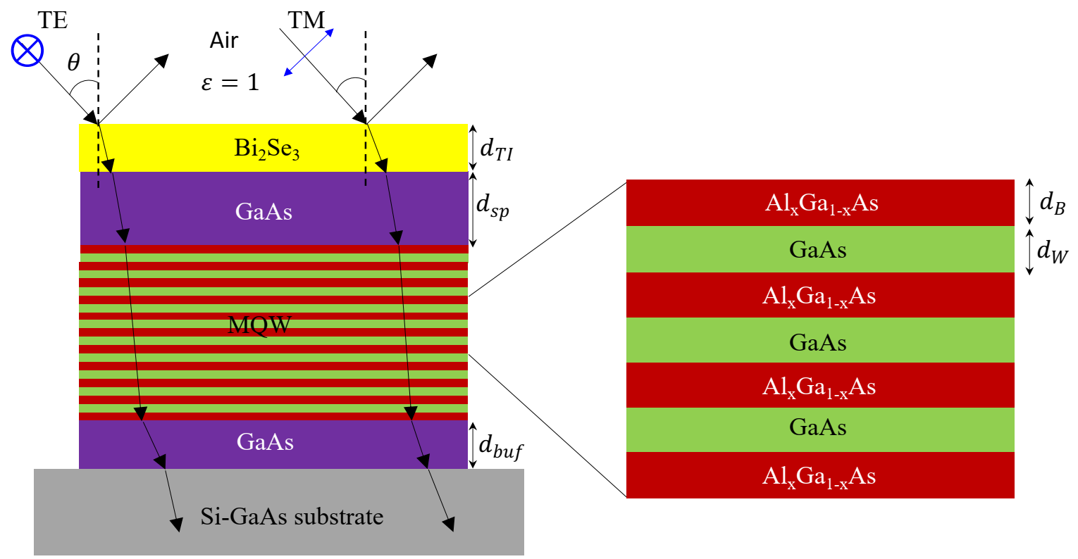
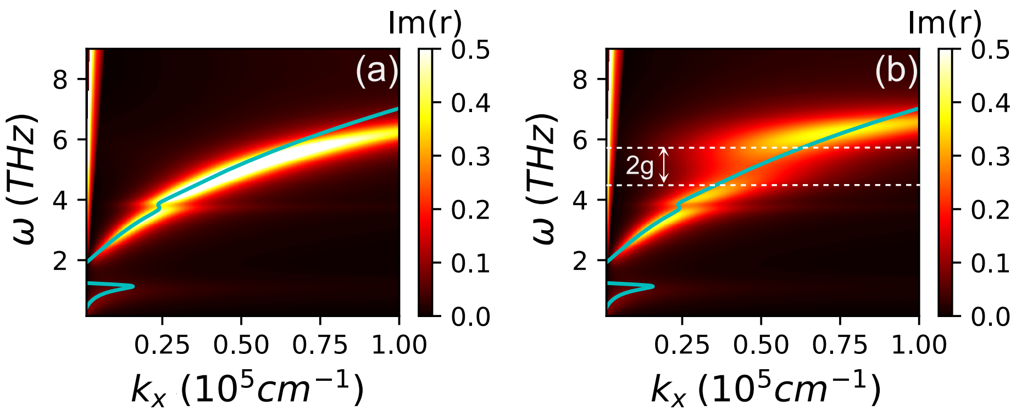
Strong coupling between a topological insulator and a III-V heterostructure at terahertz frequency
March 31, 2022
Research Focus
Theoretical prediction of strong coupling between the THz excitations in a topological insulator (TI) and a III-V quantum well. Provides potential material platform for optoelectronic device applications in the THz frequency domain.
Key Advances
State-of-the-art scattering matrix method combined with Drude-Lorentz model used for semi-classical descriptions of the interaction between TI and III-V through dispersion of Dirac plasmon-phonon-intersubband transition polariton (DPPIB).
Density functional theory calculations predict a two-dimensional hole gas at the TI-III-V interface that blueshifts the dispersion of the DPPIB.
Guides experiments by identifying parameter ranges for which strong coupling is predicted (e.g., thickness of spacer layer, doping in quantum well). Predicts that strong coupling should be achievable for experimentally-realistic material quality, which determines loss.
d_{sp}=500 nm
d_{sp}=10 nm
IRG 2
Interdisciplinary Research Group (IRG): Hybrid Quantum Materials with Emergent Terahertz Functionalities (HQ-METs)
Highlight Authors:
D. Q. To, M.F. Doty, S. Law, J.M.O. Zide, A. Janotti (University of Delaware) and
G.W. Bryant (NIST), University of Delaware MRSEC DMR-2011824
For more information: https://doi.org/10.1103/PhysRevMaterials.6.035201
Figure. Schematic of the TI/III-V heterostructure (top) and the dispersion relation of the Dirac plasmon-phonon- ISBT polarition for a Bi₂Se₃ layer interacting with a single AlGaAs/GaAs quantum well (bottom) for two different thicknesses of the GaAs spacer layer, (a) dsp = 500 and (b) 10 nm; 2g indicates the strength of the interaction between the Bi₂Se₃ and the AlGaAs/GaAs quantum well.
Notes:
Further explanation: This article, recently published in Phys. Rev. Materials 6, 035201 (2022), results from primarily-MRSEC supported research through a collaboration between IRG2 groups Doty, Law, Zide, Janotti, and Bryant (5 MRSEC faculty primary participants). This theoretical work lays the foundation and serves as a guide for setting up future experimental explorations into the coupling between a TI and a III-V heterostructure that is going to be implemented in the IRG2 group.

