Slide 1
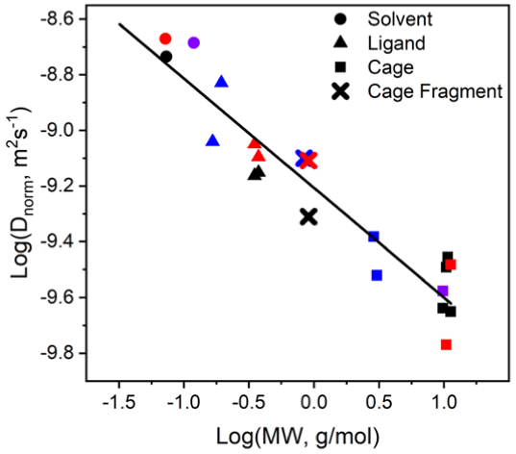
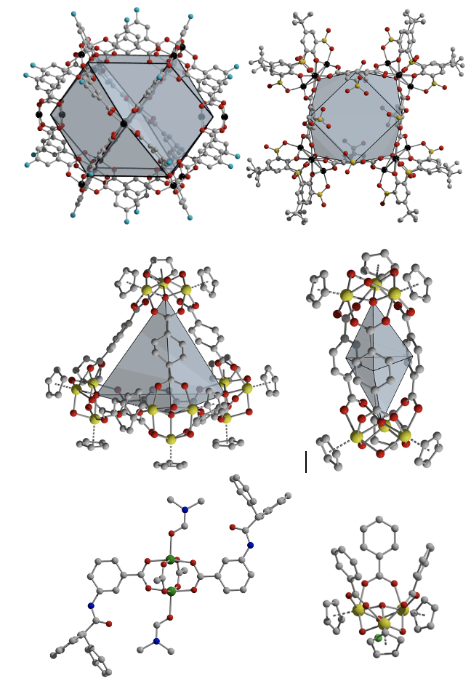
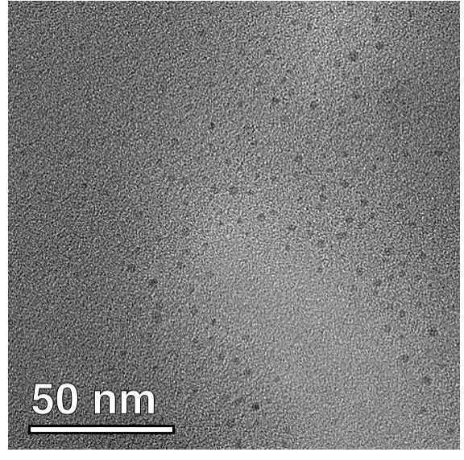
Monitoring the Solution Persistence of Porous Coordination Cages with Diffusion NMR Spectroscopy and Cryogenic Transmission Electron Microscopy
January 10, 2023
Research Focus
Diffusion NMR spectroscopy, transmission electron microscopy, and cryogenic transmission electron spectroscopy were used to characterize porous cages in solution.
A combination of the methods can be used to discriminate between assembled cages as opposed to decomposed or isomerized materials while dissolved in polar organic solvents, regardless of the metal cations used in their assembly.
Key Advances
Diffusion NMR spectroscopy was used to confirm the presence of assembled cages in solution, even when the paramagnetic nature of their constituent metal cations obscure NMR interpretation in other experiments.
Fragments of analogous cages were prepared and used to show the method is viable for these structures.
TEM and cryo-TEM both confirm that these cages, which can be highly dynamic in solution, persist under the conditions we employed.
Figure: A comparison of the molecular weight of various solvent molecules, ligands, cage fragments, and cages (right) vs. their diffusion coefficients in various solvents can be used to characterize their speciation when dissolved and compared to their solid state behavior (TEM-inset).
Interdisciplinary Research Group (IRG):
Peptide Active Materials (PAMs)
Highlight Authors:
G. Taggart, A. Guliyeva, K. Kim, G. Yap, D. Pochan, T. Epps, E. Bloch (University of Delaware)
University of Delaware MRSEC DMR-2011824
For more Information: https://doi.org/10.1021/acs.jpcc.2c07644
IRG 1
Notes:
Further explanation: This article, recently published in Biomacromolecules 2022 23 (4), 1652-1661, results from MRSEC supported research through a collaboration between IRG1 groups Saven, Pochan, and Kloxin (3 MRSEC faculty primary participants). The study used the MRSEC-supported facility.

