Slide 1
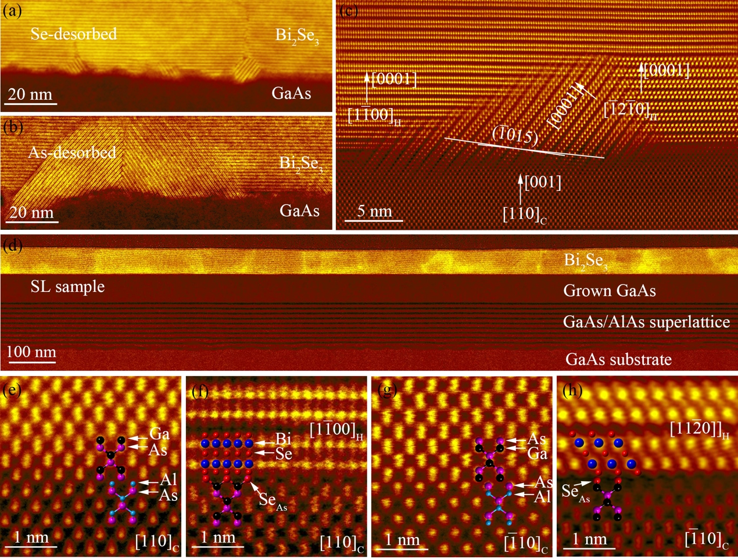
Bi₂Se₃ Growth on (001) GaAs Substrates for Terahertz Integrated Systems
December 06, 2022
Research Focus
Understanding how to integrate van der Waals materials like Bi₂Se₃ with industrially-relevant semiconductor materials like GaAs(001) using molecular beam epitaxy (MBE) for THz applications.
Determining the chemical composition and bonding type of the Bi₂Se₃/GaAs(001) interface using density functional theory (DFT) calculations.
Key Advances
Even with the highly lattice mismatched substrate GaAs(001), we can obtain high-quality, single crystalline, single orientation Bi₂Se₃ films using a superlattice smoothing layer on the GaAs substrate and in vacuo transfer to prevent interfacial oxidation.
The Bi₂Se₃/GaAs interface quality strongly influences the film quality even in van der Waals epitaxy.
DFT calculation results for the interface chemical composition indicates that the interface is Se-terminated GaAs with a van der Waals gap between the GaAs and Bi₂Se₃. STEM imaging also supports the conclusion.
Interdisciplinary Research Group (IRG):
Hybrid Quantum Materials with Emergent Terahertz Functionalities (HQ-METs)
Highlight Authors:
Y. Lui, S.Law, J.O.Zide, A.Janotti (University of Delaware), A.V.Davydov and G. Bryant (NIST)
University of Delaware MRSEC DMR-2011824
For more information: https://doi.org/10.1021/acsami.2c11135
Figure: Cross-sectional HAADF-STEM characterization of the Bi₂Se₃/GaAs interface for Se-desorbed sample (a), As-desorbed sample (b, c) and Superlattice-sample (d-h). Adapted from ACS Applied Materials & Interfaces 14(37) 42683-42691.
IRG 2
Notes:
Further explanation: This article, recently published in ACS Applied Materials & Interfaces 14(37) 42683-42691, results from primarily-MRSEC supported research through a collaboration between IRG2 groups Law, Zide, Janotti, and Bryant (MRSEC faculty primary participants) and Davydov (MRSEC Affiliate).

