Slide 1
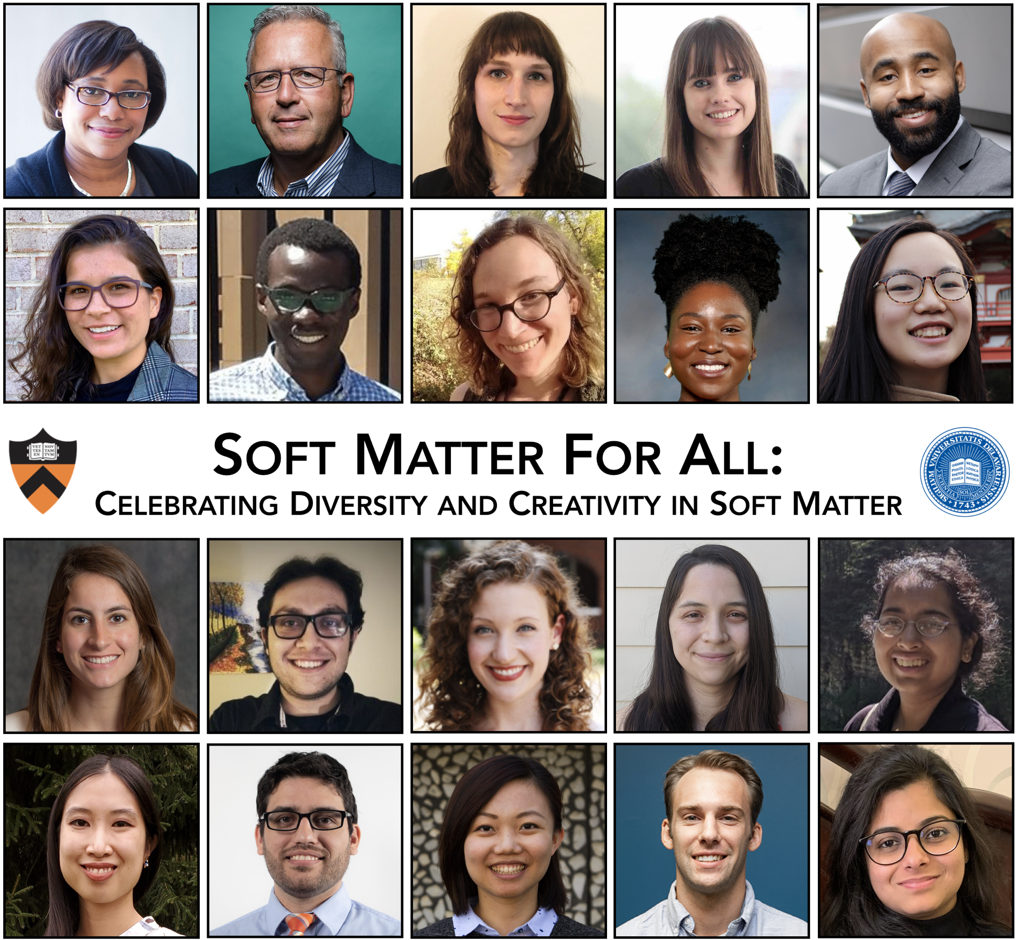
Soft Matter for All: Celebrating Diversity and Creativity in Soft Matter
October 23, 2020
MRSEC faculty at Princeton University and the University of Delaware co-hosted a virtual symposium celebrating early-career researchers in Soft and Biological Matter with a focus on those from underrepresented groups.
Two Keynote lectures from world-renowned experts and diversity champions in Soft Matter
Primer to the field of Soft Matter
Sessions highlighting creative research in biological soft matter; polymeric soft matter; and colloids, grains, and soft mechanics
Four parallel breakout sessions for speakers and participants: focused on undergraduates, graduate students, and postdocs interested in both academia and opportunities in industry and entrepreneurship
Figure 1. One-day symposium, featuring keynote speakers, Prof. Paula Hammond (MIT) and Prof. Joseph DeSimone (Carbon Inc./Stanford), and 18 early-career researchers from institutions across the U.S., highlighting the diversity and creativity of the soft matter field.
A collaboration between Princeton University and the University of Delaware
PCCM DMR-2011750
UD CHARM DMR-2011824

