Slide 1
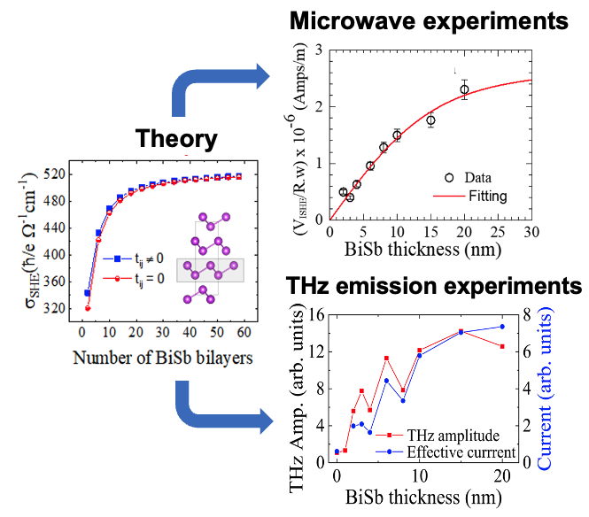
Spin-to-charge conversion in ferromagnet/ topological insulator bilayers at GHz and THz frequencies
December 20, 2021
Research Focus
Experimental studies combined with theoretical calculations of spin dynamics across a wide frequency range from ~10 GHz to several THz in a novel amorphous ferromagnet (FM)/3D topological insulator (TI) (FeGaB/BiSb) system that is scalable and provides a promising platform for spin-electronic devices.
Key Advances
FM/TI heterostructures deposited by sputtering at room temperature.
Ferromagnetic resonance and inverse spin-Hall effect measurements reveal interfacial spin-mixing conductance (5.03×10¹⁹ m^{–2}), spin-diffusion length (7.86 nm), and spin-Hall angle (0.01) of BiSb.
THz emission experiments when the bilayer is excited by femtosecond laser pulses further confirm spin-to-charge conversion in the BiSb layer.
Kubo-Bastin formula and tight-binding model reveal thickness-dependent spin-Hall conductivity of the TI films, which agrees well with experiments.
Interdisciplinary Research Group (IRG): Hybrid Quantum Materials with Emergent Terahertz Functionalities (HQ-METs)
Highlight Authors:
B. Jungfleisch, L. Gundlach, A. Janotti (University of Delaware) and G. Bryant (NIST)
University of Delaware MRSEC DMR-2011824
For more information: https://doi.org/10.1103/PhysRevMaterials.5.124410
Figure: Calculated thickness-dependent spin-Hall conductivity (left), and corresponding inverse spin-Hall voltage (top, right) and THz emission results (bottom, right). Adapted from Phys. Rev. Materials 5, 124410 (2021).
IRG 2
Notes:
NOTES: This article, recently published in Phys. Rev. Materials 5, 124410 (2021), results from primarily-MRSEC supported research through a collaboration between IRG2 groups Jungfleisch, Gundlach, Janotti and Bryant (4 MRSEC faculty primary participants) in collaboration with Prof. Ramesh Budhani at Morgan State University (non-funded external faculty collaborator). The study used the MRSEC-supported time-domain terahertz spectrometer facility.

