Slide 1

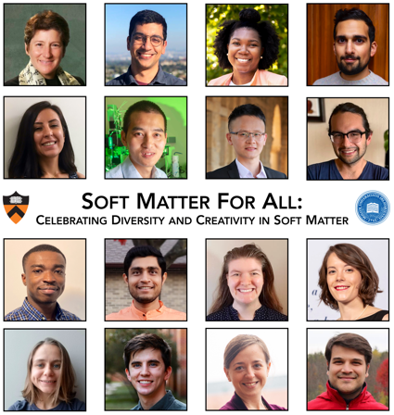
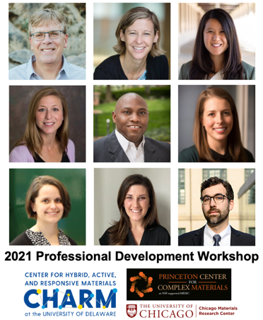

MRSEC collaborations celebrate diversity and professional growth in materials research
Education and Outreach Coordination
UD CHARM and Princeton’s PCCM coordinated with the Chicago MRSEC to host three virtual events (Soft Matter for All, Rising Stars, and a Professional Development Workshop) to highlight early career, high-impact research and ignite discussion for graduate students and postdocs pursuing academic and non-academic career paths
A common application was used for Soft Matter for All (PCCM/CHARM) and Rising Stars (Chicago); each organizing team prioritized a list of speakers and negotiated final selections; both events were run independently
The professional development workshop was led by CHARM and PCCM in coordination with Chicago
Soft Matter for All and the Professional Development Workshop were facilitated by postdocs and grad students from PCCM, CHARM, and UD EmPOWER (a graduate peer-mentoring group)
Soft Matter for All
This event was designed to celebrate diversity in soft materials research through the promotion of exceptional science
Prof. Julia Kornfield (Caltech) delivered a powerful keynote on the mentorship that impacted the research highlights across her career, followed by scientific talks from 7 postdocs and 8 graduate students; these speakers represented 14 academic institutions across North America
Early career research talks spanned rheology and colloidal, biological, and polymeric soft matter
Keynote and speakers
October 15th, 2021
(262 registered)
Keynotes and panelists
November 4th, 2021
(197 registered)
December 20, 2021
K. Bothi, T. Epps, III, L. Korley
University of Delaware MRSEC
DMR-2011824
Professional Development Workshop
The event was kicked off by two keynotes: Prof. Tim Long (ASU) reflected on his professional pathway linking academia and industry, and Prof. Jen Heemstra (Emory) reminded our attendees that self-care is essential for strong performance
Two panels covered non-academic (policy, industry, government, and entrepreneurship) and academic paths, and provided attendees with the opportunity to ask questions and share knowledge
Notes:
NOTES:
For more information about the November 4th Professional Development Workshop, visit https://mrsec.udel.edu/2021/10/18/early-career-mrsec-professional-development-workshop-on-nov-4th/.
Speaker bios and talk titles for the October 15th Soft Matter for All event can be found at https://mrsec.udel.edu/2021/09/22/soft-matter-for-all-returning-in-october-2021-2/.

