Slide 1
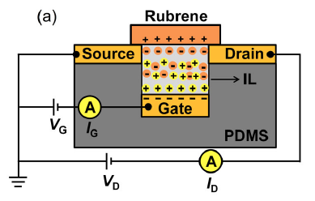
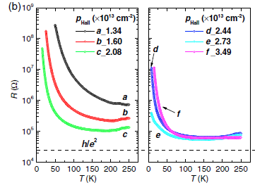
Approaching a Two-Dimensional (2D) Metallic State on the Surface of the Organic Semiconductor Rubrene
Principal Investigators
Dan Frisbie and Chris Leighton (IRG-1)
Description and Significance
Whether metallic behavior can exist in 2D materials is a question that has troubled condensed matter physics for decades. Although originally thought impossible, evidence for such in ultra-clean doped inorganic semiconductors like Si and GaAs eventually changed the prevailing view. Research performed in IRG-1 using an approach to doping known as electrolyte gating has now shown that highly conductive (close to metallic) behavior can also be seen in 2D in an organic semiconductor, rubrene. This was enabled by techniques that increase the density of holes on the surface by a thousand times over prior work. The mobility of the holes in rubrene remains far lower than inorganic semiconductors, however, raising perplexing questions about the origin of the conductive state.
Supported by UMN MRSEC Award DMR# 1420013
Xie, Wang, Zhang, Leighton and Frisbie,
Phys. Rev. Lett. 113, 246602 (2014)
Notes:
This work was performed by MRSEC student and postdoc Wei Xie and Shun Wang, working collaboratively between the groups of Dan Frisbie and Chris Leighton in IRG-1. Devices of the type shown in the figure were made to initially create vacuum-gapped transistors, the gap then being filled with the ionic liquid [P14][FAP]. This enables induction of hole densities up to 6 x 10¹³ cm⁻² on the surface of rubrene single crystals, at least three orders of magnitude higher than in the prior state-of-the-art vacuum-gapped structures. The mobility falls only to about 5 cm²V⁻¹s⁻¹, however, which results in a massive increase in conductance compared to prior work. Measurements to low temperatures revealed a quickly collapsing insulating state, at 3 x 10¹³ cm⁻² being replaced with conduction very close to weak localization or even an insulator-metal transition. Metallic behavior in resistance is seen down to 120 K, at which point the resistance reaches within a factor of 2 of the quantum value (dotted horizontal line in the figure). This is the universal value at which a metallic state should emerge in 2D. Interestingly, further increase in the carrier density induced a reentrant insulating state, which is poorly understood, although the resulting conductance peak was indeed confirmed in this work to be truly a mobility peak. Further work is underway to understand it.
Supported by UMN MRSEC Award DMR# 1420013

