Slide 1
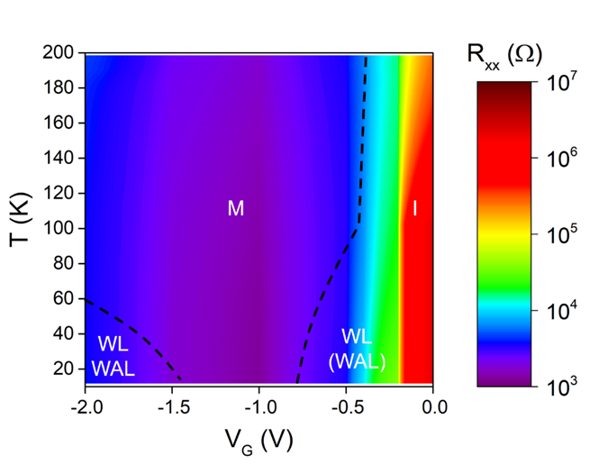
From Semiconductor to Metal in Two-dimensional Tellurium
UMN MRSEC Award DMR# 1420013
2020
Chris Leighton & Dan Frisbie (IRG-1)
University of Minnesota
Intellectual Merit
Atomically-thin sheets of semiconductors have been of immense interest since the Nobel-Prize-winning discovery of graphene or two-dimensional (2D) carbon. Such materials represent the ultimate limit of “scaling” to small sizes, of vital importance in the semiconductor device industry. A particularly exciting recent (2017) finding is that the elemental semiconductor tellurium can be created in 2D sheets, with highly mobile electrons. In this work, University of Minnesota investigators in MRSEC IRG-1 applied “electrolyte gating” to this new material, using the motion of ions to control electronic properties. A transition from semiconductor to metal was found, enabling mapping of the electronic properties of “tellurene” over an extraordinary range. This work highlights not only the potential of tellurene for electronic devices, but also the general power of electrolyte gating (an IRG-1 focus) in 2D materials research.
X. Ren, Y. Wang, Z. Xie, F. Xue, C. Leighton and
C.D. Frisbie, Nano Lett. 19, 4738 (2019)
Notes:
Tellurene is a recently discovered 2D material with high hole mobility and air stability, rendering it a good candidate for future applications in electronics, optoelectronics, and energy devices. However, the physical properties of tellurene remain poorly understood. In this paper, we report on the fabrication and characterization of high-performance electrolyte-gated transistors (EGTs) based on solution-grown tellurene flakes <30 nm in thickness. Both Hall measurements and resistance–temperature behavior down to 2 K are recorded at multiple gate voltages, and an electronic phase diagram is generated. The results show that it is possible to cross the insulator–metal transition in tellurene EGTs by tuning gate voltage, achieving mobility up to ∼500 cm2 V–1 s–1. In particular, a truly metallic 2D state is observed at gate-induced hole densities >1 × 1013 cm–2, as confirmed by the temperature dependence of resistance and magnetoresistance measurements. Wide-range tuning of the electronic ground state of tellurene is thus achievable in EGTs, opening up new opportunities to realize electrical control of its physical properties.

