Slide 1
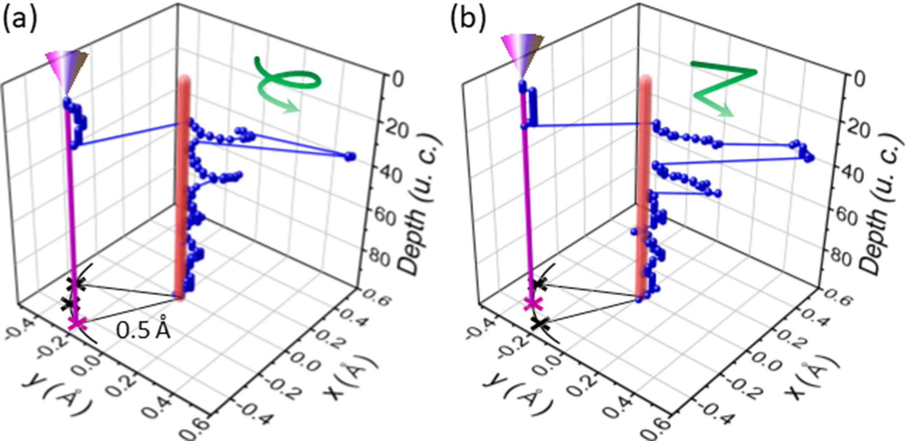
Subatomic Channeling and Spiraling Electron Beams in Crystals
UMN MRSEC Award DMR# 1420013
2019
K. Andre Mkhoyan (IRG-2), University of Minnesota
Intellectual Merit
Using analytical aberration-corrected scanning transmission electron microscopy (STEM), we studied the behavior of the electron probe propagating in SrTiO₃ at sub-atomic length scales. For the very first time, we discovered the unusual nature of sub-atomic beam channeling in crystalline material. In some cases electrons of the probe channel along the atomic column with pendulum-like motion, moving side-to-side inside the atoms. In the other cases, they spiral within the atoms forming a helicon-type beam. In the figure, the position of the peak intensity of the propagating beam (in unit cells, u.c.) located near the oxygen atomic column is shown for these two cases. This discovery suggests that there is a rich sub-atomic science to be explored using these beams. Atomic-scale magnetism is one field that can benefit dramatically from this discovery of spiraling electron beams in crystals.
J. S. Jeong, H. Song, J. T. Held, K. A. Mkhoyan, Phys. Rev. Lett. 2019, 122, 075501.
10.1103/PhysRevLett.122.075501
Notes:
Inspired by recent experimental subatomic measurements using analytical aberration-corrected scanning transmission electron microscopes, we study electron probe propagation in crystalline SrTiO3 at the subatomic length scale. Here, we report the existence of subatomic channeling and the formation of a helicon-type beam at this scale. The results of beam propagation simulations, which are performed at various crystal temperatures, STEM probe convergence angles (10–50 mrad), and beam energies (80–300 keV), showed that reducing the ambient temperature can enhance the subatomic channeling and STEM probe parameters can be used to control the features of helicon-type beams.

