Slide 1
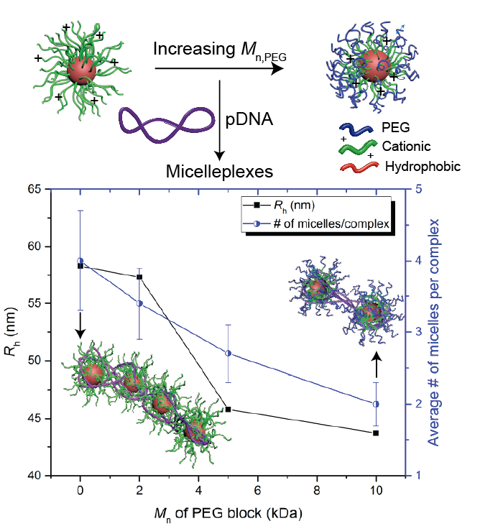
ABC Micelleplexes: Precise Compaction and High Colloidal Stability
UMN MRSEC Award DMR# 1420013
2019
Timothy Lodge & Theresa Reineke (IRG-3), University of Minnesota
Intellectual Merit
The versatility of polyelectrolyte complexes resides in the facile incorporation of multiple chemical components in the composing polyions, which allows design of complexes with intricate structures and multiple functionalities. In this work, the complexation of ABC micelles with a model semiflexible polyion, DNA, is systematically investigated to correlate the structure of the micelle with the properties of the resulting “micelleplexes”. With the addition of a nonionic outer corona, the colloidal stability of the resulting micelleplexes dramatically improves and is maintained over a wide range of charge ratios. At the same time, the size, composition and structure of micelleplexes can be tuned by varying the nonionic outer corona length without compromising the colloidal stability. These results demonstrate a new strategy to compact long chain polyions and design nanoparticles with superior colloidal stability and tunable composition.
Y. Jiang, T. P. Lodge, T. M. Reineke, J. Am. Chem. Soc., 140, 11101-1111 (2018)
Notes:
Compaction of DNA by oppositely charged nanoparticles is a fundamental phenomenon in nature and of great interest to developing therapeutics. In addition, the ability to orthogonally control the composition and structure of interpolyelectrolyte complexes is needed to develop materials for diverse applications. Herein, we systematically investigate the complexation of plasmid DNA and polymeric cationic AB and ABC micelles to explore the influence of micelle outer nonionic corona length on the colloidal stability, size, composition, and structure of the resulting “micelleplexes”. The micelles were selfassembled from amphiphilic block polymers, poly(ethylene glycol)-block-poly((2-dimethylamino)ethyl methacrylate)-blockpoly(n-butyl methacrylate) (PEG-b-PDMAEMA-b-PnBMA), and PDMAEMA-b-PnBMA with the same Mn of PDMAEMA. These spherical micelles have similar hydrodynamic radii and core sizes, but the Mn of the outer PEG block ranged from 0 to 10 kDa. The colloidal stability of micelleplexes as a function of stoichiometric charge ratio was assessed by turbidimetric titration and was found to dramatically improve with the addition of an outer PEG corona, even as short as 2 kDa. With the use of a combination of dynamic and static light scattering, ζ-potential, and cryogenic transmission electron microscopy, it was found that the size, composition, and structure of micelleplexes are closely correlated with the Mn of the PEG block. Indeed, these micelleplexes were found to adopt beads-on-a-string morphologies that resemble the general structure of chromatin, and the number of micelles per micelleplex systematically decreased with increasing PEG length. These findings demonstrate the power of polycationic micelles to condense DNA into biomimetic structures and provide a mechanistic understanding of nucleic acid complexation and of how micelle architecture affects the properties of micelleplexes, while offering an appealing strategy to control the properties of micelleplexes by tuning a single parameter.

