Slide 1
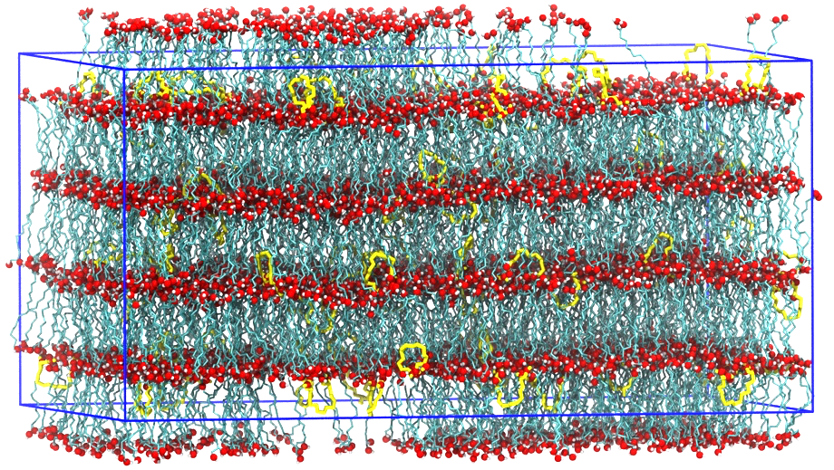
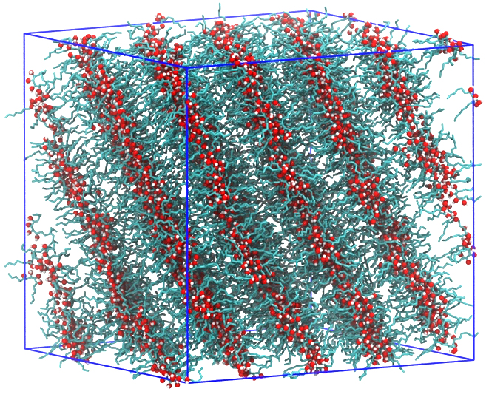
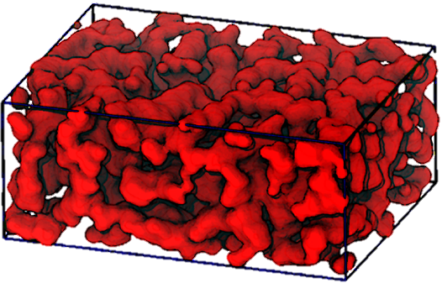
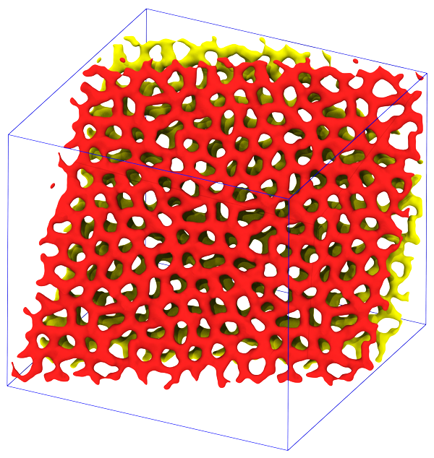
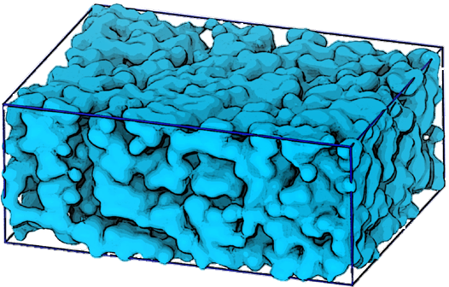
Computational Design of Triblock
Amphiphiles with 1-nm Domains
UMN MRSEC Award DMR# 1420013
2020
Intellectual Merit
Block polymers are a class of versatile self-assembling soft materials that can form exquisite nanostructures for applications including ion transport membranes for batteries and fuel cells, and templates for inorganic oxide catalysts. Using molecular dynamics simulations and transferable force fields, we designed a series of symmetric triblock amphiphiles (or high-𝜒 “block oligomers”) comprising incompatible sugar-based (A) and hydrocarbon (B) blocks that can self-assemble into ordered nanostructures with full domain pitches as small as 1.2 nm. Depending on the chain length and block sequence, the ordered morphologies include lamellae (LAM), perforated lamellae, and hexagonally-perforated lamellae (HPL). Above the order-disorder transition temperature, the disordered states are locally well-segregated and form bicontinuous network phases. This study furnishes detailed insights into structure-property relationships for mesophase formation on the 1-nm length scale that will aid further miniaturization for numerous applications.
Theresa Reineke, Timothy Lodge & Ilja Siepmann (IRG-3), Mahesh Mahanthappa (Seed), University of Minnesota
A₂B₁₂A₂ in LAM state with
few LOOP conformations
B₆A₄B₆ in HPL state
A₂B₁₀A₂ with continuous polar and nonpolar regions
Z. Shen, J. L. Chen, V. Vernadskaia, S. P. Ertem, M. K. Mahanthappa, M. A. Hillmyer, T. M. Reineke, T. P. Lodge &
J. I. Siepmann, J. Am. Chem. Soc., (2020)
DOI: 10.1021/jacs.0c01829
Notes:
Using molecular dynamics simulations and transferable force fields, we designed a series of symmetric triblock amphiphiles (or high-χ block oligomers) comprising incompatible sugar-based (A) and hydrocarbon (B) blocks that can self-assemble into ordered nanostructures with sub 1-nm domains and full domain pitches as small as 1.2 nm. Depending on the chain length and block sequence, the ordered morphologies include lamellae, perforated lamellae, and hexagonally-perforated lamellae. The self-assembly of these amphiphiles bears some similarities, but also some differences, to those formed by symmetric triblock polymers. In lamellae formed by ABA amphiphiles, the fraction of B blocks “bridging” between polar domains is nearly unity, much higher than that found for symmetric triblock polymers, and the bridging molecules adopt elongated conformations. In contrast, “looping” conformations are prevalent for A blocks of BAB amphiphiles. Above the order-disorder transition temperature, the disordered states are locally well-segregated yet the B blocks of ABA amphiphiles are significantly less stretched than in the lamellar phases. Analysis of both hydrogen-bonded and nonpolar clusters reveals the bicontinuous nature of these network phases. This simulation study furnishes detailed insights into structure-property relationships for mesophase formation on the 1-nm length scale that will aid further miniaturization for numerous applications.

