Slide 1
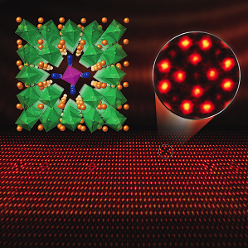
Discovery of a New Line Defect in a Perovskite Oxide
UMN MRSEC Award DMR# 1420013
2017
Bharat Jalan & Renata Wentzcovitch (IRG-1),
Andre Mkhoyan (IRG-2), University of Minnesota
Intellectual Merit
Defects, essentially locations in a crystal where the perfect arrangement of atoms is disturbed, are inherent in materials, and play a key role in their function. As they have been studied for so long, the discovery of new types of defects is rare. In recent work in IRGs 1 and 2 a completely new type of defect has been found in a class of complex oxide materials called perovskites, specifically the compound NdTiO₃. This new defect is a “line” defect formed by a long local region of the crystal that rotates from the typical ordering pattern, as shown in the figure. This discovery was enabled by combining state-of-the-art synthesis methods with atomic resolution electron microscopy and complex computations, requiring collaboration between three MRSEC research groups with complementary expertise. One potential application lies in engineering such line defects to create atomic-scale “tunnels” for the flow of electrons or atoms.
J.S. Jeong, M. Topsakal, P. Xu, B. Jalan,
R. Wentzcovitch and K.A. Mkhoyan,
Nano Lett. 16, 6816 (2016)
Notes:
This is work performed in the Mkhoyan, Jalan and Wentzcovitch groups in IRGs 1 and 2. The team studied NdTiO₃/SrTiO₃ superlattices grown by oxide MBE and then examined by aberration-corrected STEM/EELS. The new line defect is a local region where the unit cell is rotated by 45 degrees with respect to the bulk axes, accompanied by atomic displacements and vacancy formation. This is a quite complex local arrangement, determined in the work by STEM imaging and local EELS, and verified in DFT calculations by Wentzcovitch. The basic ingredients for formation are multivalent ions, slight off stoichiometry, and lattice strain, which are common in perovskite films, and thus it may well form in some other systems. The work was published as Jeong, Topsakal, Xu, Jalan, Wentzcovitch, and Mkhoyan, Nano Lett. 16, 6816 (2016)

