Slide 1
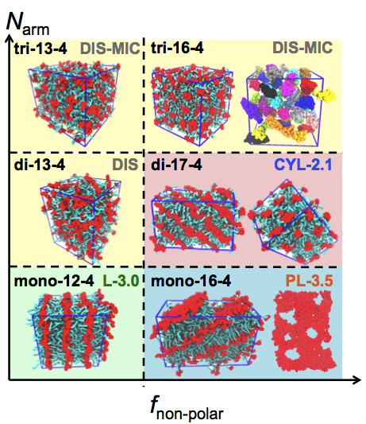
Computational Design of High-χ Block Oligomers for Accessing 1-nm Features
UMN MRSEC Award DMR# 1420013
2018
Ilja Siepmann & Tim Lodge & Marc Hillmyer (IRG-3), University of Minnesota
Intellectual Merit
The ability to precisely predict how molecular structure influences the microstructure of polymeric materials is the key towards the custom tailoring of desirable materials properties. Molecular dynamics simulations with atomistic level models were performed to design “high-χ” block oligomers that can self-assemble into 1-5 nm domains for next generation microelectronics applications. Simulations show that the microstructures formed by these oligomers can be tuned by varying the molecular weight and the chain architecture. The results are being used to guide the synthesis of block oligomers for desired microstructural morphologies and domain periods. In particular, these results open a path to significantly smaller features than previously obtained by block polymer self-assembly.
Simulation snapshots of meso-phases formed by H(CHOH)_{x}(CH₂)_{y}H oligomers (polar in red and nonpolar in cyan) including Lamellae, Perforated Lamellae, Cylinders, and Disordered Micelles. DOI: 10.1021/acsnano.7b09122
Q. P. Chen, L. Barreda, L. E. Oquendo, M. A. Hillmyer,
T. P. Lodge, J. I. Siepmann, ACS Nano, 12, 4351-4361
(2018)
Notes:
Molecular dynamics simulations are used to design a series of high-χ block oligomers (HCBOs) that can self-assemble into a variety of mesophases with domain sizes as small as 1 nm. The exploration of these oligomers with various chain lengths, volume fractions, and chain architectures at multiple temperatures reveals the presence of ordered lamellae, perforated lamellae, and hexagonally packed cylinders. The achieved periods are as small as 3.0 and 2.1 nm for lamellae and cylinders, respectively, which correspond to polar domains of approximately 1 nm. Interestingly, the detailed phase behavior of these oligomers is distinct from that of either solvent-free surfactants or block polymers. The simulations reveal that the behavior of these HCBOs is a product of an interplay between both “surfactant factors” (headgroup interactions, chain flexibility, and interfacial curvature) and “block polymer factors” (χ, chain length N, and volume fraction f). This insight promotes the understanding of molecular features pivotal for mesophase formation at the sub-5 nm length scale, which facilitates the design of HCBOs tailored toward particular desired morphologies.

