Slide 1
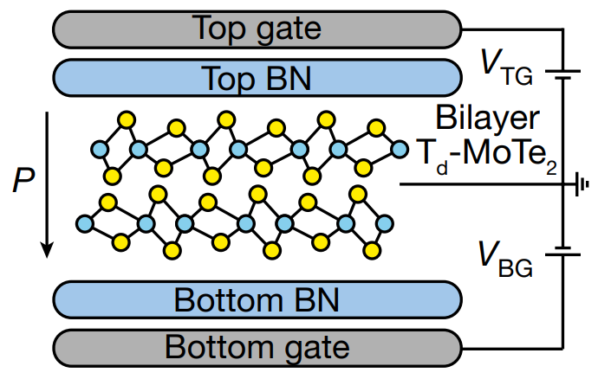

University of Minnesota MRSEC
DMR-2011401
Ferroelectric Superconductivity in a Transition Metal Dichalcogenide
A. Saha, T. Birol, R. Fernandes (IRG-1)
For the first time, a team comprised of two IRG-1 theorists (Birol and Fernandes) working with experimentalists from other institutions (including the Columbia MRSEC) showed the coexistence of ferroelectricity (i.e., electrostatically switchable macroscopic dipole moment) and superconductivity in a two-dimensional superconductor. The material is bilayer MoTe₂, a member of the family of transition metal dichalcogenides, which are compounds of high interest in IRG-1. This important result opens a new avenue to the control of superconductivity by electrostatic means.
The IRG-1 team’s theoretical approach combined first-principles and model calculations. Theoretical calculations were performed by IRG-1 student Amartyajyoti Saha. The theoretical analysis attributes the unique superconducting behavior of MoTe₂ as a function of gating to an unconventional pairing state, thus shedding new light on the phenomenon of superconductivity in two-dimensional materials, of broad interest.
A. Jindal, A. Saha, Z. Li, T. Taniguchi, K. Watanabe, J. C. Hone,
T. Birol, R. M. Fernandes, C. R. Dean, A. N. Pasupathy, D. A. Rhodes,
Nature, 2023, 613, 48–52. 10.1038/s41586-022-05521-3
Notes:
What Has Been Achieved: First time that a switchable ferroelectric state is shown to coexist with superconductivity. The UMN IRG-1 team explained (through a tight-binding model built on first principles Wannier functions) the nature of superconductivity in this material.
Importance of the Achievement: Metallic ferroelectrics that are switchable are rare, so even without superconductivity this would have been an interesting finding. But the fact that the polarization has an effect on superconductivity makes it even more interesting.
How is the achievement related to the IRG, and how does it help it achieve its goals? The material is a transition metal dichalcogenide, which is a family that was proposed to be studied in IRG-1 proposal. The work elucidates the effect of an electrostatic displacement field on these materials, so is related to the theme of electrostatic gating. (Though there are no electrochemical effects in this material.)
Where the findings are published: “Coupled ferroelectricity and superconductivity in bilayer T_{d}-MoTe₂”, Apoorv Jindal, Amartyajyoti Saha, Zizhong Li, Takashi Taniguchi, Kenji Watanabe, James C. Hone, Turan Birol, Rafael M. Fernandes, Cory R. Dean, Abhay N. Pasupathy & Daniel A. Rhodes, Nature 613, 48–52 (2023).
1

