Slide 1
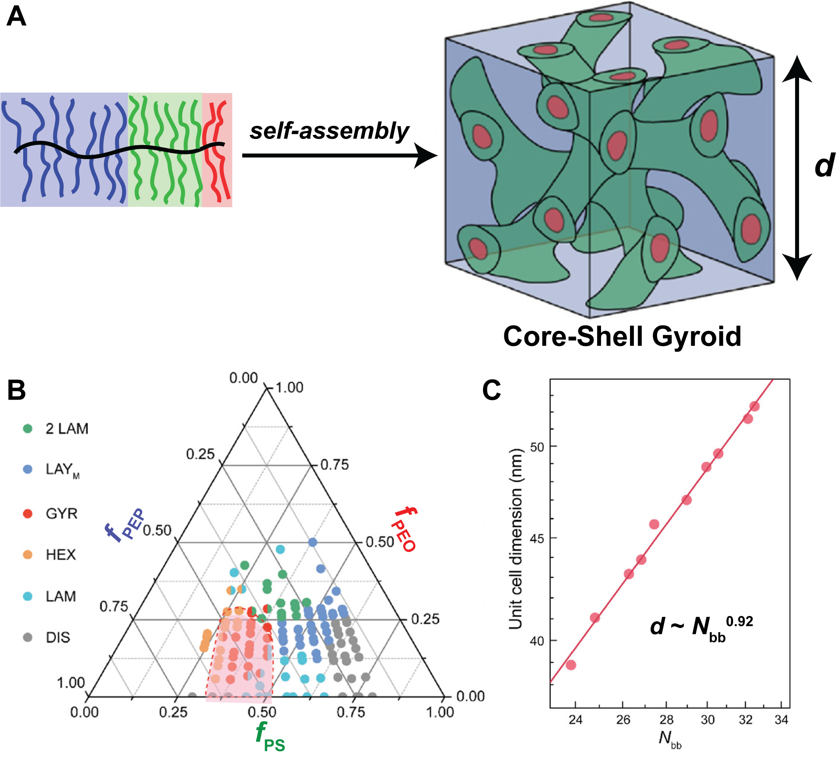
University of Minnesota MRSEC
DMR-2011401
Core-Shell Gyroid in ABC Bottlebrush Block Terpolymers
S Cui, B. Zhang, L. Shen, F. S. Bates, T. P. Lodge (IRG-2)
A principal obstacle to widespread applications of self-assembled network morphologies (Nets) of linear block polymers is access to only limited pore diameters and unit cell dimensions (typically <50 nm), originating from their coil configurations and slow self-assembly kinetics at high molar masses. A bottlebrush molecular architecture with extended backbone configurations due to side chain crowding could circumvent these shortcomings. However, Nets are very rarely observed in block bottlebrush polymers.
IRG-2 researchers systematically explored the phase behavior of 25 AB diblock and 108 ABC triblock bottlebrush polymers. A core-shell double gyroid Net was achieved in a substantial subset of the ABC triblock bottlebrush terpolymers for the first time. Encouragingly, the unit cell dimensions (d) of these assemblies increase almost linearly with molecular weight, portending the ability to access larger Net dimensions than previously obtained with linear block polymers for potential optical materials applications.
S. Cui, B. Zhang, L. Y. Shen, F. S. Bates, T. P. Lodge,
J. Am. Chem. Soc., 2022, 144, 21719-21727. 10.1021/jacs.2c09674
(A) Core-shell double gyroid phase self-assembled from a ABC triblock bottlebrush terpolymers. (B) Morphology diagram for ABC triblock bottlebrush terpolymers. (C) Power law fitting of gyroid unit cell dimensions as a function of backbone degree of polymerization.
Notes:
What Has Been Achieved: We systematically explored the phase behavior by temperature-dependent small-angle X-ray scattering (SAXS) of 25 PEP-PS diblock and 108 PEP-PS-PEO triblock bottlebrush polymers prepared by sequential ring-opening metathesis polymerization (ROMP) of norbornene-functionalized poly(ethylene-alt-propylene) (PEP), poly(styrene) (PS), and poly(ethylene oxide) (PEO) macromonomers. The PEP-PS diblocks exhibited only cylindrical and lamellar morphologies; the desired networks phases (Nets) did not form in these materials, consistent with prior experimental studies and contrary to self-consistent field theory (SCFT) predictions. However, appending variable length bottlebrush PEO blocks to the PEP-PS diblocks drives the formation of the first core-shell double gyroid Net phases over a wide composition window in the ternary phase portrait; this discovery constitutes only the second example of a Net phase from bottlebrush block copolymer self-assembly. Encouragingly, the gyroid unit cell dimensions increased almost linearly (d ~ N_{bb}^{0.92}) with the backbone degree of polymerization N_{bb}.
Importance of the Achievement: This work achieves the core-shell double gyroid network phase from block bottlebrushes self-assembly for the first time, paving the way to generating ordered networks with previously unattainable large unit cell dimensions, owing to the intrinsically stiff polymer backbones of the bottlebrush blocks. Discovery of the core-shell double gyroid network phase should also motivate development of new theoretical approaches capable of accurately treating finite molecular weight bottlebrush molecular architectures
How is the achievement related to the IRG, and how does it help it achieve its goals? Our achievement paves the way to generating ordered mesoscale networks with large unit cells by self-assembly toward materials with exciting optical properties– a key overall goal of the IRG. Furthermore, this core-shell double gyroid phase in block bottlebrush polymers provides an excellent platform for understanding polymer self-assembly, while promoting further exploration of the periodic network materials.
Where the findings are published: S. Cui, B. Zhang, L. Y. Shen, F. S. Bates, T. P. Lodge, J. Am. Chem. Soc. 2022, 144, 21719-21727. DOI: 10.1021/jacs.2c09674

