Slide 1
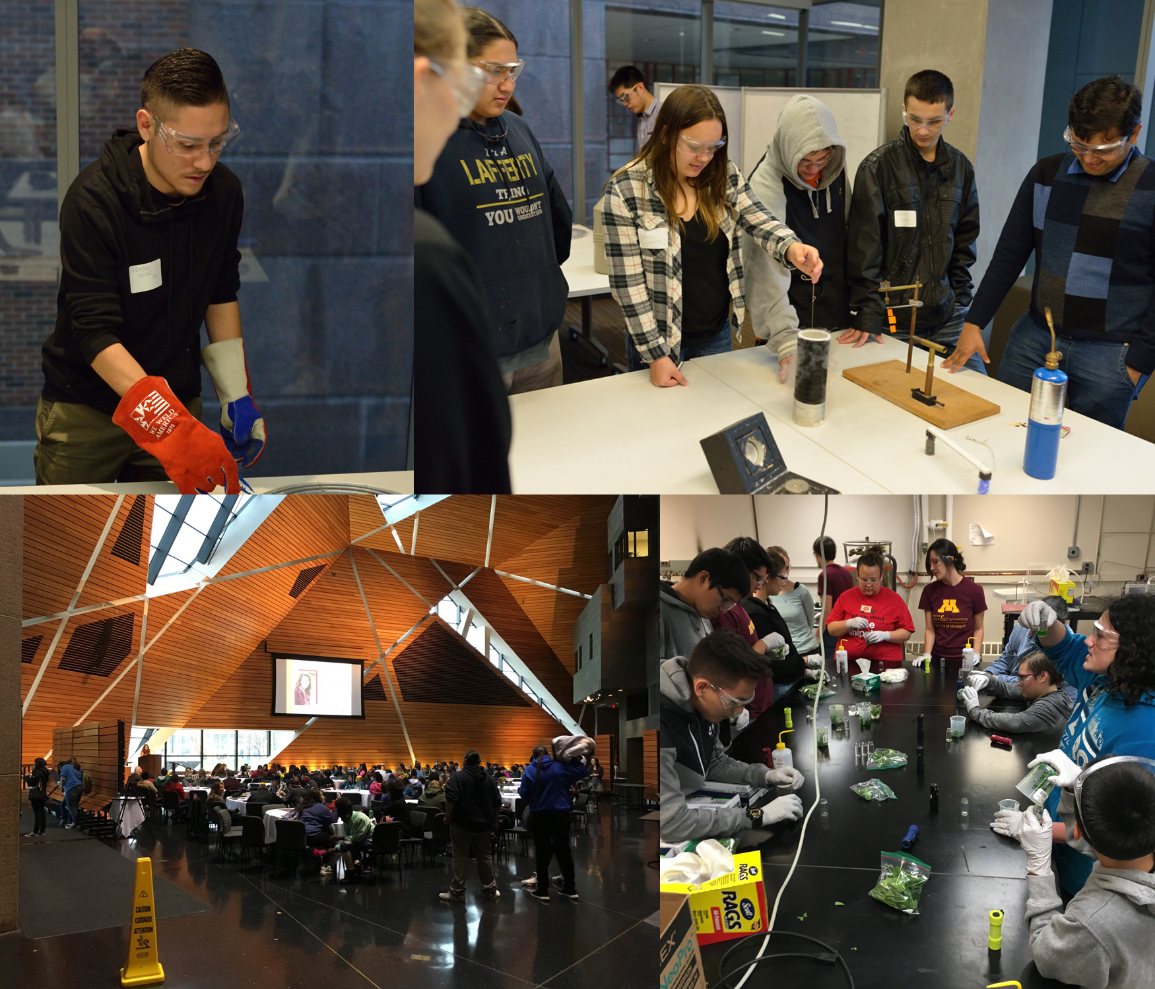
American Indian Visit Day
Description and Significance
In 2015, the University of Minnesota MRSEC expanded its American Indian Outreach activities with the inaugural American Indian Visit Day. On November 7, 2015, 270 American Indian middle and high school students were invited to UMN for a day of activities to introduce opportunities in STEM available at UMN. The students participated in hands on activities presented by each of the three MRSEC IRGs exposing them to research in multiple science and engineering fields. Additionally, the students toured campus cultural offices and heard from American Indian student and alumni speakers. Students also participated in a college application workshop and were able submit applications to UMN on site at no cost.
Supported by UMN MRSEC Award DMR# 1420013
Notes:
In 2015, the University of Minnesota MRSEC expanded its American Indian Outreach activities with the inaugural American Indian Visit Day. On November 7, 2015, 270 American Indian middle and high school students were invited to UMN for a day of activities to introduce opportunities in STEM available at UMN. The students participated in hands on activities presented by each of the three MRSEC IRGs exposing them to research in multiple science and engineering fields. Additionally, the students toured campus cultural offices and heard from American Indian student and alumni speakers. Students also participated in a college application workshop and were able submit applications to UMN on site at no cost.

