Slide 1
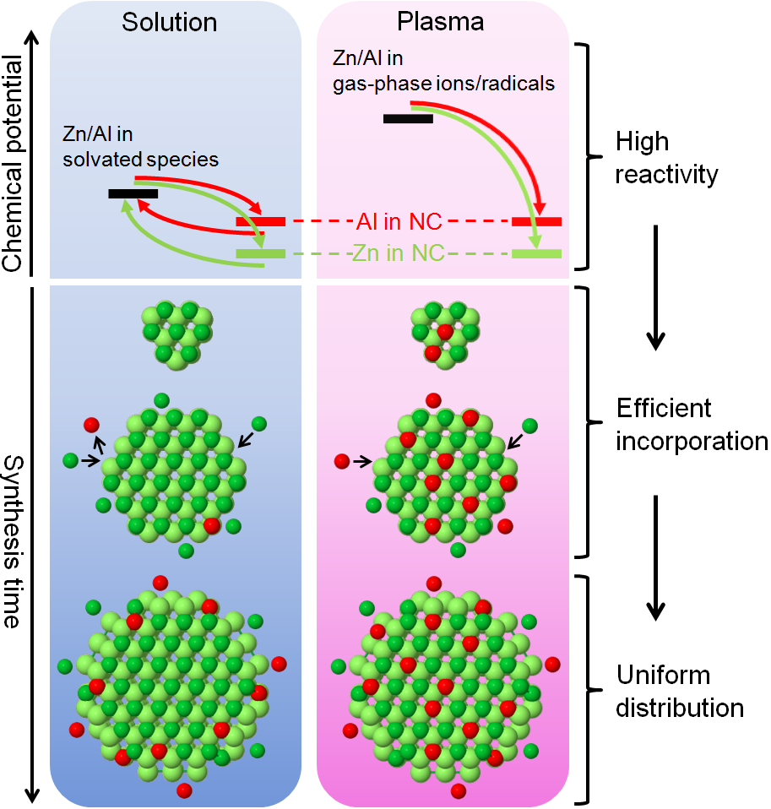
Efficient and uniform doping of zinc oxide nanocrystals via plasma synthesis
Doping in solution vs. doping in plasma
Principal Investigators
Eray Aydil, Uwe Kortshagen,
Andre Mkhoyan (IRG-2)
Description and Significance
Doping is essential for controlling the optical and electronic properties of compound semiconductor nanocrystals. In solution-based synthesis, often doping efficiencies are low and dopants are excluded from the nanocrystals’ central cores. The research team developed a fundamentally different plasma-based process for synthesizing aluminum-doped zinc oxide nanocrystals. Due to the high chemical reactivities of the doping species in the plasma, dopants were incorporated irreversibly throughout nanocrystal growth, resulting in high doping efficiency and uniform dopant distribution.
Supported by UMN MRSEC Award
DMR# 1420013
Kortshagen, Aydil, Mkhoyan et al. Nano Lett. 2015, 15, 8162–8169.

Slide 2
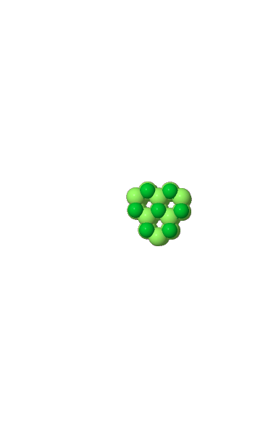
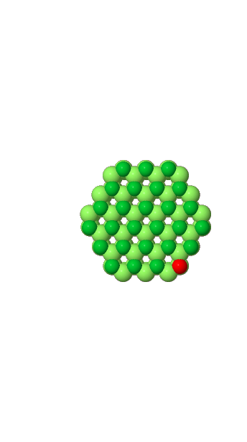

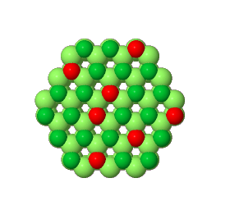


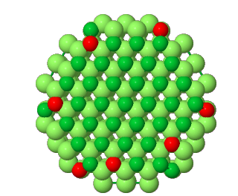
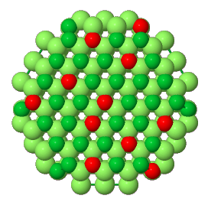
Solution
Plasma
Zn/Al in
gas-phase ions/radicals
Zn/Al in
solvated species
High
reactivity
Chemical potential
Al in NC
Zn in NC
Efficient
incorporation
Synthesis time
Uniform
distribution

