Slide 1

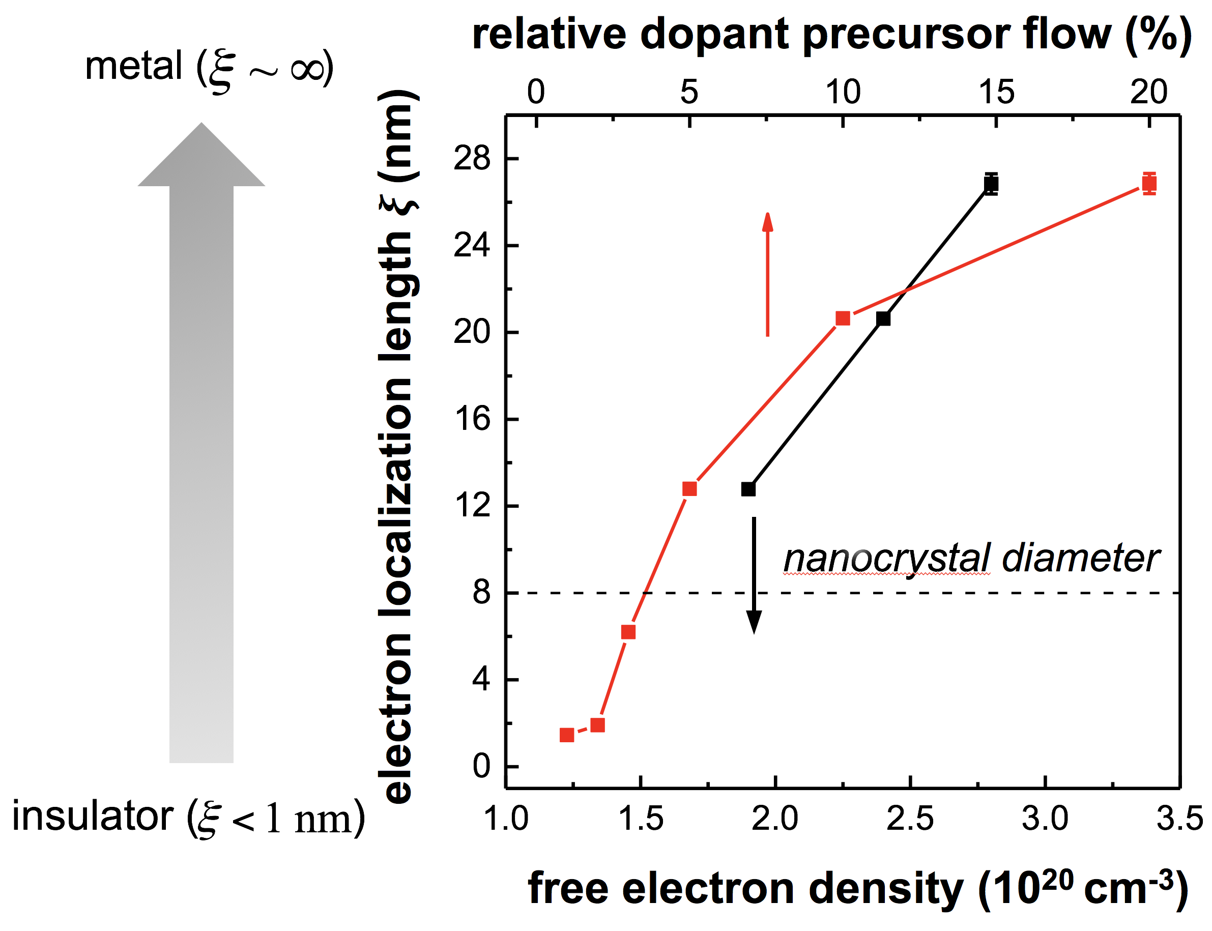
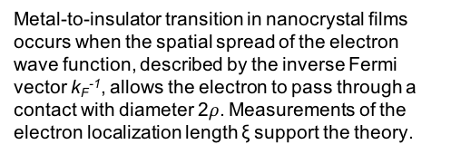


How many electrons make a nanocrystal film metallic?
Principal Investigator
Uwe Kortshagen, Boris Shklovskii (IRG-2)
Description and Significance
Understanding the transport of electrons in films of touching nanocrystals is of central importance for their future use in printed electronic devices such as light emitting diodes, solar cells, or transistors. The research team developed a new theory that describes the transition of the electron conduction in doped nanocrystal films from a semiconducting to a metallic behavior. The theory predicts that the transition occurs under strikingly different conditions from those previously known for bulk semiconductors. Associated experimental studies of the electron conduction in phosphorous-doped silicon nanocrystal films largely support the new theory. This study was reported in Nature Materials.
Supported by UMN MRSEC Award
DMR# 1420013
$$2ρ$$
$$\sim k_{F}^{−1}$$
Metal-to-insulator transition in nanocrystal films occurs when the spatial spread of the electron wave function, described by the inverse Fermi vector k_{F}⁻¹, allows the electron to pass through a contact with diameter 2$ρ$. Measurements of the electron localization length ξ support the theory.

Slide 2
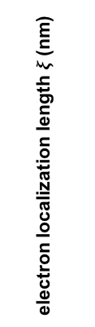

metal ( )
relative dopant precursor flow (%)
$$2ρ$$
$$\sim k_{F}^{−1}$$
electron localization length $ξ$(nm)
nanocrystal diameter
insulator ( )
free electron density (10²⁰ cm⁻³)

