Slide 1
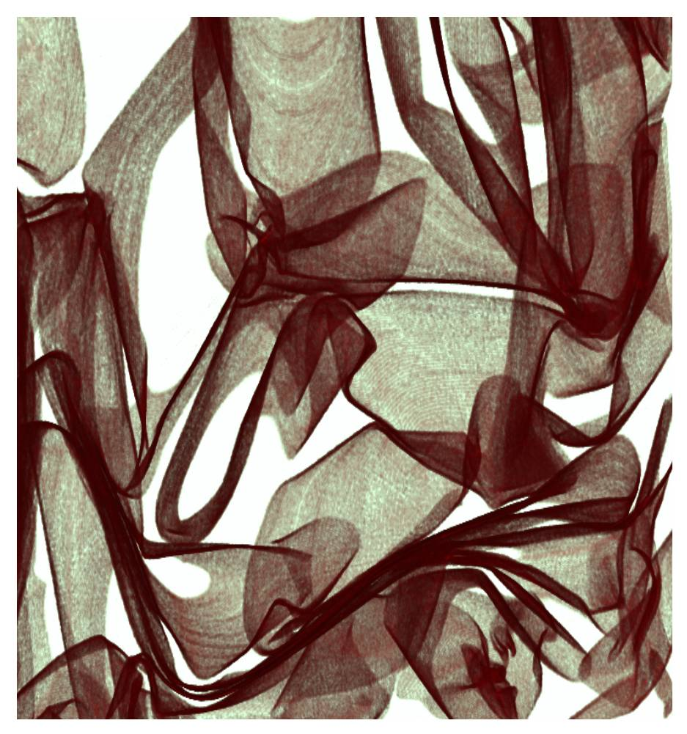
3-dimensional structure of a sheet crumpled into a sphere
Inside a Crumpled Ball
The crumpling or crushing of paper, aluminum foil, or even a car fender is an everyday occurrence that is surprisingly rich in new physical and materials principles. Working in the Materials Research Science and Engineering Center (MRSEC) on Polymers at the University of Massachusetts Amherst, Menon and Russell used X-ray microtomography experiments on foils crushed into a ball to understand their detailed 3D structure. These measurements reveal that the internal 3-dimensional geometry of a crumpled ball is in many respects isotropic and homogeneous. Crumpling recapitulates classic nonequilibrium problems such as turbulence, where a system driven by long-wavelength and low-symmetry forces shows only rather subtle fingerprints of the forcing mechanism. However, the researchers found local nematic ordering of the sheet into parallel stacks, a surprising results that will help physicists and materials scientists better understand these complex structures. The extent of this stacking or layering increased with the volume fraction, or degree of compression. Stacking of the material into thicker “walls” may be either an alternative or an assistive mechanism to the formation of ridges, and impart structural rigidity to the material.
Notes:
When a thin sheet is crushed into a small three-dimensional volume, it invariably forms a structure with a low volume fraction but high resistance to further compression. Being a far-from-equilibrium process, forced crumpling is not necessarily amenable to a statistical description in which the parameters of the initially flat sheet and the final confinement fully specify the resulting crumpled state. Instead, the internal geometry and mechanical properties of the crumpled ball may reflect the history of its preparation.
We have performed X-ray microtomography experiments on foils crushed into a ball to uncover their detailed 3D structure. These measurements reveal that the internal 3-dimensional geometry of a crumpled ball is in many respects isotropic and homogeneous. In these respects, crumpling recapitulates other classic nonequilibrium problems such as turbulence, where a system driven by long-wavelength, low-symmetry, forcing shows only rather subtle fingerprints of the forcing mechanism. However, we find local nematic ordering of the sheet into parallel stacks. The layering proceeds radially inwards from the outer surface. The extent of this layering increases with the volume fraction, or degree of compression. Stacking of the material into thicker “walls” may be either an alternative or an assistive mechanism to the formation of ridges, in endowing the crumpled material with structural rigidity.

