Slide 1
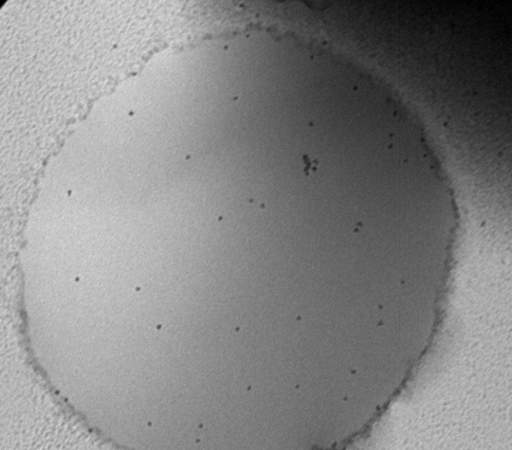
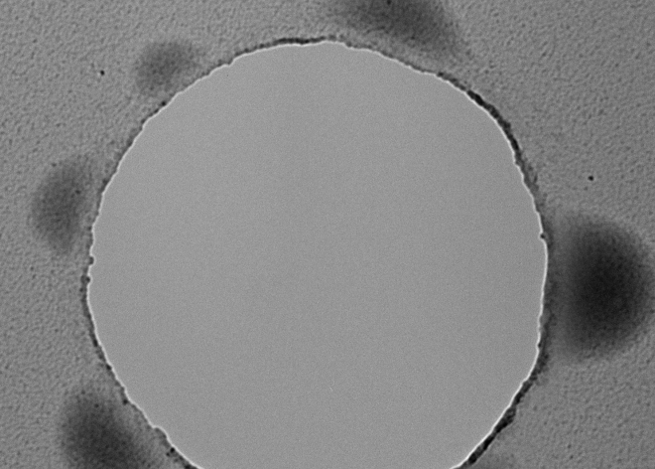
Nanoscale Imaging of Wet Polymer Materials
The molecular- and nano-scale structure of bulk materials can be imaged only by transmission electron microscopy (TEM), a technique that requires high vacuum (low pressure). Until now, this constraint made TEM incompatible with ‘wet’ materials, such as molecules dispersed in a liquid or gels swollen by a solvent. Working at the Materials Research Science and Engineering Center (MRSEC) on Polymers at UMass Amherst, Hoagland, McCarthy, and Russell successfully imaged the fine structure of wet polymeric materials prepared with ionic liquids. These non-volatile liquids dissolve or solvate an interesting spectrum of ‘soft’ polymer systems of fundamental and technological interest. A key objective is to refine the approach so that the dynamics of such systems can be imaged in situ and in real time, accomplishing tasks akin to those known from optical microscopy but at much smaller length scales. Shown below are two images, taken 1 second apart, of an ionic liquid spanning a 1-μm opening in a carbon film. Suspended in the liquid are polymer-coated nanoparticle tracers. In the interval between images, the thin film, originally spread over the opening, has destabilized by breaking into ~100-nm droplets that distribute around the rim. Nano- and micro-scale wetting transitions are key to numerous technologies ranging from microfluidics to ultralyophobic surfaces, but these transitions have never been visualized experimentally.
100 nm
Time zero
t = 1 second
Notes:
The molecular- and nano-scale structure of bulk materials can only be imaged by transmission electron microscopy, a technique that places the materials under a very high vacuum. Until now, the high vacuum requirement has made transmission electron microscopy imaging incompatible with ‘wet’ materials, those such as gels that contain a high solvent fraction. To view the fine structure of such materials, samples have traditional been first frozen (i.e., cryo-TEM), a step not only eliminating any prospect for observing materials dynamics but also potentially introducing artifacts from solvent crystallization. Ionic liquids break this imaging dilemma, as they are essentially nonvolatile and thereby stable as liquids at high vacuum. We are developing the ionic liquid-microscopy experimental approach from several perspectives, but a key goal has been to refine the approach so that dynamics of wet polymeric systems can be imaged in real time and in situ, replicating at much smaller length scales the highly developed benefits of optical microscopy for directly observing material dynamics in the time domain.
Shown below are two images, taken 1 min apart, of an ionic liquid wetting a 1 μm opening of a holey carbon film; suspended in the liquid are polymer-coated nanoparticle tracers. In the interval between images, the thin film, originally spread over the opening, has destablilized by breaking into ~100-nm droplets that distribute around the opening’s rim (the break-up actually takes much less than a second). Nano- and micro-scale wetting transitions are key to numerous technologies ranging from microfluidics to ultralyophobic surfaces, but these transitions have never before been experimentally visualized.

