Slide 1
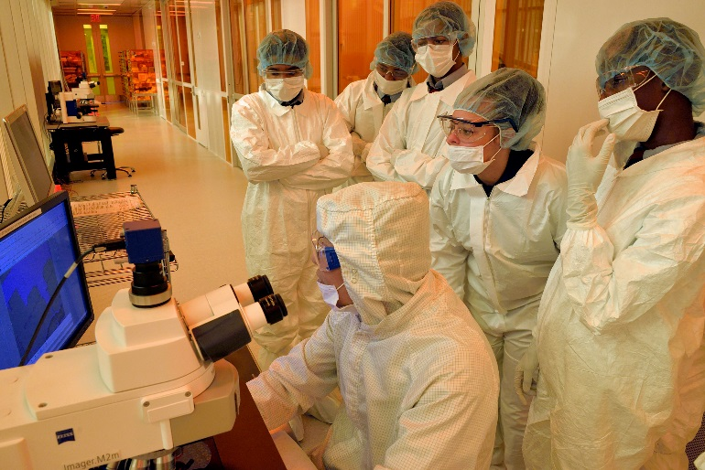
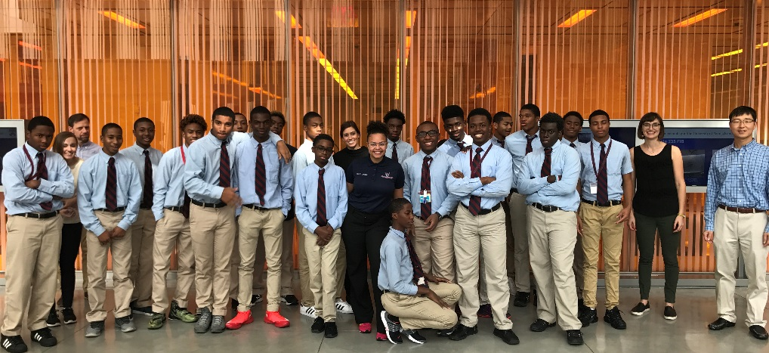
Field Trip Series
NSF MRSEC DMR-11-20901
2017
Sophia Seifert & Mark Licurse LRSM, University of Pennsylvania
Starting in 2017, the LRSM and Singh Center for Nanotechnology hosted monthly field trips for Philadelphia middle and high school students. During these visits, students had introductory lessons on Materials Science and Nanotechnology and suited up for the clean room at the Quattrone Nanofabrication facility, where they observed and, when possible, assisted with lithography and soft-lithography.
124 students from four schools participated in the field trip program, of which 81% were URM and 96% were low-income (i.e., they qualify for the Federal Free and Reduced Lunch program).

