Slide 1
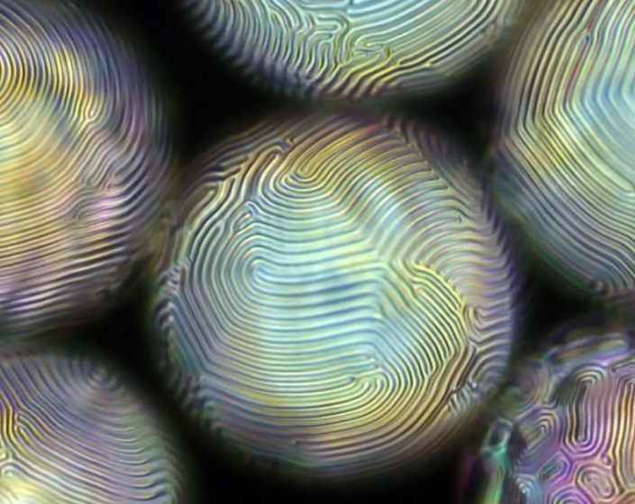
Shells of Cholesteric Liquid Crystals
NSF MRSEC DMR-11-20901
2017
Daeyeon Lee, Kathleen Stebe, and Randall Kamien IRG1, University of Pennsylvania
Liquid crystals, fluids with aligned phases of rod-like constituent molecules, are used in everything from computer and television displays to mood rings. “Handedness” or chirality, is ubiquitous in complex biological systems and can be controlled and quantified in synthetic materials such as cholesteric liquid crystals.
Lee, Stebe, and Kamien investigated spherical shells of cholesteric liquid crystals in water. The cholesteric liquid crystals align and twist in specific configurations as a result of a delicate balance of elastic energy, geometry, and surface alignment. Interestingly, the shell confinement leads to a plethora of new liquid crystal states and associated surface structures that look like fingerprints (see figure).
Because liquid crystals are similar to oil, “soap” molecules called surfactants are attracted to the liquid crystal shells. The concentration of surfactants affects the anchoring of the cholesteric liquid crystals (CLCs) at the shell walls, causing the CLC molecules to order in different ways and create striking patterns. The more surfactant added to the solution, the more the patterns changed. Adding water caused the patterns to reverse.
Fingerprint patterns result from focal conic domains that form on inner surfaces of spherical shells filled with cholesteric liquid crystals.
This striking new ability to control the patterns that form in the spherical shell could prove useful for arranging nanoparticles and for creating patchy microscopic CLC drops suspended in water. The patches offer the possibility to attach specific molecules to specific spots on the drop. Ordered nanoparticles on the drop surface hold potential in sensing applications.
L. Tran, M.O. Lavrentovich, G. Durey, A. Darmon, M.F. Haase, N. Li, D. Lee, K.J. Stebe, R.D. Kamien, T. Lopez-Leon, Phys. Rev. X 7, 2017

