Slide 1
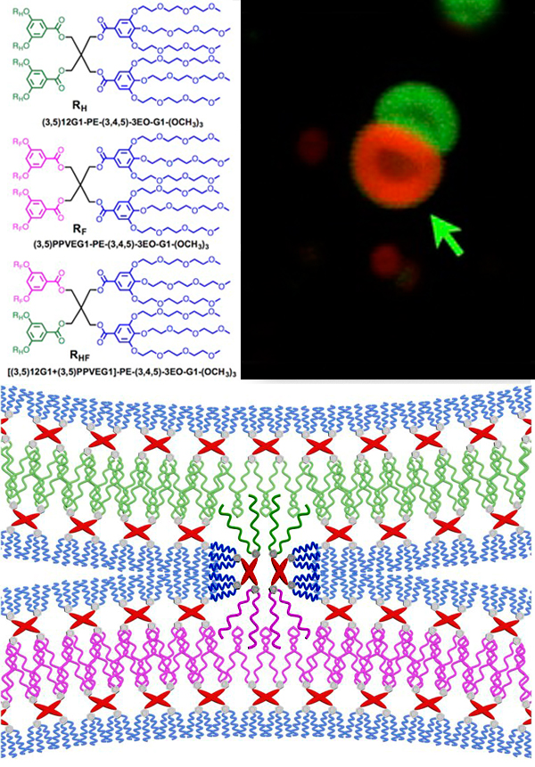
Janus dendrimersomes as models for cell fusion and fission.
NSF MRSEC DMR-11-20901
2017
Virgil Percec, Michael Klein, Dan Hammer, and Tobias Baumgart IRG2, University of Pennsylvania & Temple University
Vesicle fusion and fission processes often occur in biological systems, usually with the aid of specialized proteins. Percec, Klein, Hammer, and Baumgart carried out comprehensive fusion/fission experiments based on three membrane ingredients: hydrogenated (R_{H}), fluorinated (R_{F}), and hybrid-hydrogenated/fluorinated (R_{HF}) Janus dendrimers (Figure – Top Left).
By varying the ratio of the three Janus dendrimers in solution, they were able to create a range of soft “containers” (vesicles) ranging from isolated vesicles to dumbbell-shaped fused Janus dendrimersomes (Figure – Top Right). The latter is a vesicle made from hydrogenated Janus dendrimers bonded to a vesicle made from fluorinated Janus dendrimers.
From computer modeling, microscopy & electron microscopy, a model for fusion was derived. The key feature for fusion is the hybrid-hydrogenated/fluorinated Janus dendrimersome that enters the membrane & bridges between the different vesicles (Figure – Bottom).
The work demonstrates that fusion/fission can be mediated with only three simple membrane elements, as long as composition is carefully controlled.
Q. Xiao, S.E. Sherman, S.E. Wilner, X. Zhou, C. Dazen, T. Baumgart, E.H. Reed, D.A. Hammer, W. Shinoda, M.L. Klein, V. Percec, PNAS, 114, 2017

