Slide 1
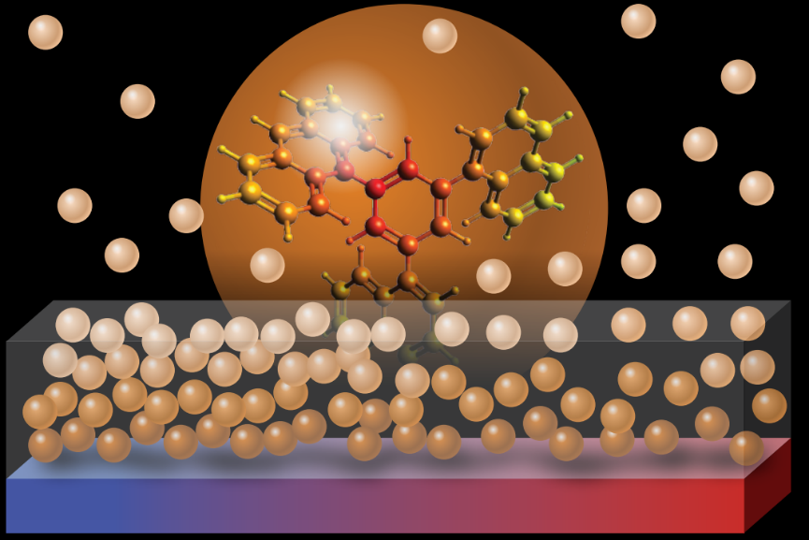
Birefringent Stable Glasses with Predominantly Isotropic Molecular Orientation
NSF MRSEC DMR-11-20901
2017
Zahra Fakhraai and Jay Kikkawa IRG3, University of Pennsylvania
Stable glasses produced by physical vapor deposition are important to understand. They exhibit optical birefringence, which traditionally implies that the constituent molecules are aligned.
Fakhraai and Kikkawa produced and carefully characterized stable glasses of anthracene molecules that retain their three-dimensional shape and do not preferentially align in a specific direction. Using a combination of angle-and polarization-dependent photoluminescence and ellipsometry experiments, they showed that these stable glasses possess a predominantly isotropic molecular orientation while remaining optically birefringent. The intrinsic birefringence, which is still not understood, appeared to be correlated with increased density. The work suggests that long-range molecular ordering is not required to produce stable glasses or optical birefringence.
The work provides new data and insights into the process of stable glass formation via surface-mediated equilibration.
Schematic of glass films formed by physical vapor deposition.
T. Liu, A.L. Exarhos, E. C. Alguire, F. Gao, E. Salami-Ranjbaran, K. Cheng, T. Jia, J.E. Subotnik, P.J. Walsh, J.M. Kikkawa, Z. Fakhraai, Phys. Rev. Lett. 119, 2017

