Slide 1
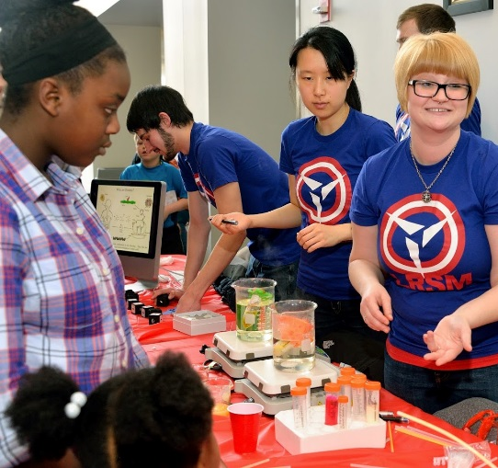
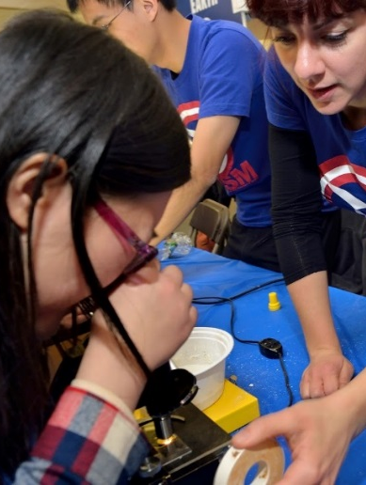
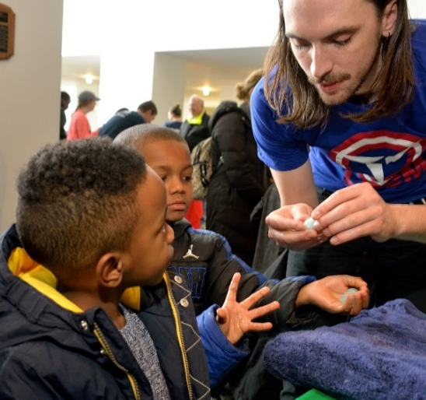
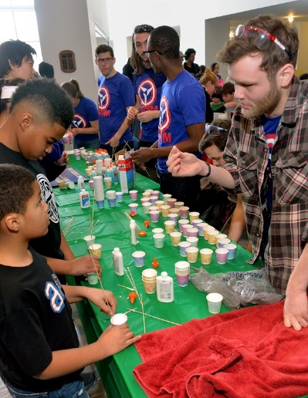

6th Annual Philadelphia Materials Day
A. R. McGhie & M. W. Licurse
The 6th annual Philadelphia Materials Day was held on Saturday, February 6, 2016 at the Bossone Research Center at Drexel University. This joint venture between Penn and Drexel Universities was attended by over 1100 students and parents. Each year faculty and their students present demos on materials-related themes of interest to K-12 students. The themes this year were: Communications, Earth, Environment, Energy, and Sports. We had our highest MRSEC participation with 11 groups of affiliated faculty present, which included those of Professors Eric Schelter, Neil Tomson, James Petersson, Rob Carpick, Kevin Turner, Lee Bassett, Karen Winey, Russ Composto, Shu Yang, Charlie Johnson, and Arjun Yodh.
Support: Primary NSF MRSEC DMR-11-20901
Notes:
Technical Explanation if needed

