Slide 1
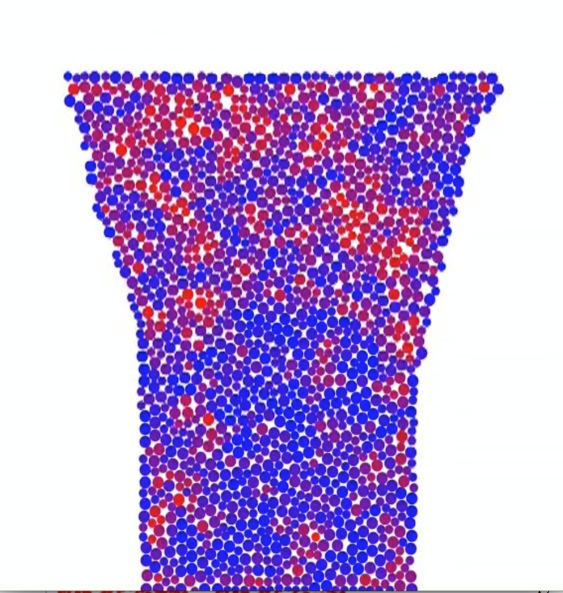
Identifying Structural Flow Defects in Disordered Solids Using Machine Learning Methods D. J. Durian, E. Kaxiras (Harvard MRSEC), A. J. Liu (IRG-3)
We are often taught that the difference between solids and liquids is that in solids, each of the constituent particles has a well-defined average position while in liquids, particles are constantly rearranging and changing their neighbors. In fact, particle rearrangements do occur in solids, and all solids flow under enough stress. Crystalline solids flow via localized particle rearrangements that occur preferentially at structural defects known as dislocations. The population of dislocations therefore controls how crystalline solids flow. In disordered solids, there is considerable evidence that localized particle rearrangements induced by stress occur at localized flow defects. However, for more than 40 years, all attempts to identify them directly from the structure have failed. Here we introduce a novel application of machine learning data mining methods to diagnose flow defects, or “soft” particles from their local structural environments. We follow the softness of each particle as it evolves under stress. Our results show that machine learning methods can be used to gain a conceptual understanding that has not been achieved with conventional approaches.
Snapshot of a two-dimensional experimental granular pillar being compressed by moving the top plate downwards (gravity is into the page). The color of each particle indicates its softness (its structural propensity to rearrange), from a blue (low softness) to red (high softness) scale.
E.D. Cubuk, et al. Phys. Rev. Lett. 114, 108001 (2015).
Support: Primary NSF MRSEC DMR-11-20901
Notes:
We have developed a novel machine learning method for identifying flow defects in disordered solids. We note that we cannot predict the specific particles that will participate in rearrangements at a later time; rather, we identify a population of particles that is likely to rearrange. The latter quantity is more useful in thermal and/or sheared systems, since fluctuations lead to stochasticity in rearrangements. Our method relies on local structure alone and can be
applied directly to snapshots of experimental systems, in contrast to previous methods that we developed based on quasilocalized normal modes. Our approach also scales
linearly with the number of particles N, while vibrational mode approaches scale as N³. The efficient identification of flow defects is critical for following the dynamical process of mechanical failure. Previous applications of machine-learning methods in physics have focused on approximation or on optimization and design tools. Our approach
shows that such methods, designed for detecting subtle correlations, can also be used directly to gain conceptual physical understanding.

