Slide 1
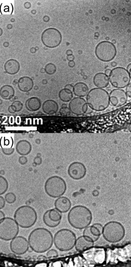
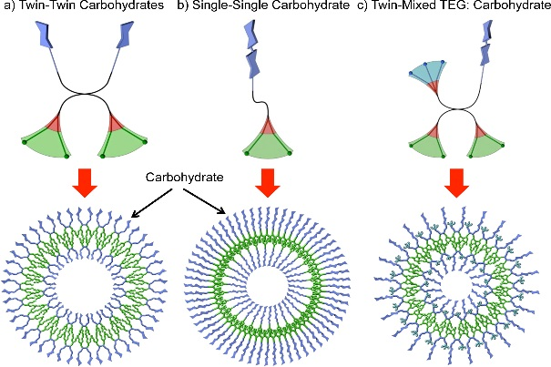
Synthesis, self-assembly and response of glycodendrimers Virgil Percec, Paul A. Heiney and Mike Klein (IRG2)
Dendrimers are branched molecules of precise chemistry, and Janus-dendrimers are dendrimers that have two distinct faces, with unique chemistry corresponding to each face. Here, we made a library of carbohydrate containing glycodendrimers (GD) that self assemble into vesicles – a structure that mimics biological materials such as viruses. We show the vesicles have the ability to agglutinate lectin proteins at vesicle walls, owing to the chemistry and concentration of the carbohydrate. Synthesis of these materials is the first step in the assembly of a synthetic virus.
Cryo-TEM confirming the formation of glycodendrimersomes.
Three different topologies of amphiphilic Janus GD and the corresponding structures: (a) “Twin-Twin Carbohydrates”, (b) “Single-Single Carbohydrate” and (c) “Twin-Mixed TEG:Carbohydrate”. Color code: hydrophilic (blue), hydrophobic (green), aromatic (red).
Support: Primary NSF MRSEC DMR-11-20901
Notes:
Technical Explanation if needed

