Slide 1
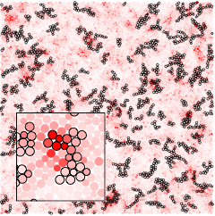
Understanding Plastic Deformation in Glasses from Single-Soft-Spot Dynamics Andrea J. Liu (IRG 3), Robert A. Riggleman (Seed 3)
In crystalline materials, topologial defects such as dislocations mark flow defects, or “soft spots,” corresponding to local regions that are likely to rearrange due to thermal fluctuations or an applied load. In disordered packings, it is extremely difficult to identify the corresponding soft spots. We previously discovered that sound waves are strongly scattered by flow defects, enabling us to identify soft spots acoustically. We use numerical simulations of a steady-state sheared glass to show that particle rearrangements occur preferentially at soft spots over a range of temperatures, from well below the glass transition to above it. Furthermore, we find that the lifetimes of individual soft spots are related directly to the relaxation time of the material under steady shear. Together, these results suggest that one may be able to develop a soft-spot or defect-mediated approach to understand the glass transition from the low-temperature side.
Our work paves the way towards a description of disordered packings in terms of an underlying population of soft spots. In analogy with crystals, such an understanding could help us tailor the design of disordered solids with specific mechanical properties.
The particles in a two-dimensional simulated glass as it is sheared. Particles are colored red according the magnitude of their displacements, and particles outlined in black are predicted as soft (likely to rearrange under shear). Approximately 70% of rearrangements occur at soft particles.
SS Schoenholz, AJ Liu, RA Riggleman, J Rottler, Physical Review X 4, 031014 (2014).
Support: Primary NSF MRSEC DMR-11-20901
Notes:
Technical Explanation if needed

