Slide 1
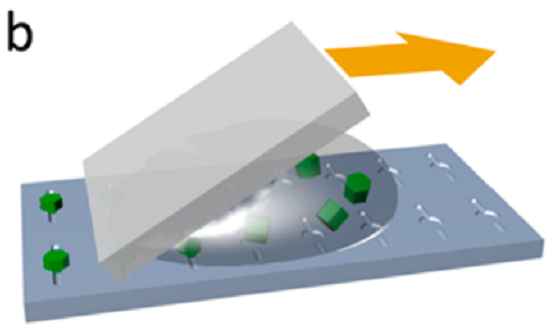
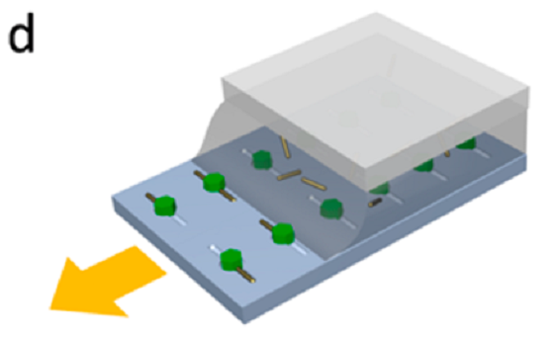
IRG-4 Plasmonic Enhancement of Upconversion in Nanorod/Nanophosphor Heterodimers
N. Engheta, C. B. Murray, C. R. Kagan (IRG4)
A central goal of IRG-4 is to use collective interactions between dissimilar nanocrystals to enhance the performance of their assemblies.
Here we demonstrate plasmonic enhancement of optical upconversion luminescence within nanorod-nanophosphor heterodimers (Fig 1a-c).
Using experiment and theory we are able to develop design rules for optimizing heterodimer geometry.
The templated assembly process (Fig 1d-e) can be used for many other nanocrystal building blocks and for larger assemblies.
(d)
(e)
Figure 1 – (a) SEM image of a nanorod/nanophosphor heterodimer created using template-assisted self-assembly. Upconverted light emission for excitation polarization (b) longitudinal and (c) transverse to the nanorod axis. Strong emission for longitudinal polarization reflects plasmonic enhancement of absorption. Schematics showing the (d) “squeegee” and (e) capillary template-assembly methods developed.
ACS Nano 8, 9482-9491, (2014).
Support: Primary NSF MRSEC DMR-11-20901
Notes:
Notes for the non-specialist: Nanophosphors can convert light from long wavelengths to shorter wavelengths, which are desirable in applications. Our team combined nanoscale fabrication and optical expertise of Kagan, the synthetic expertise of Murray, and the electromagnetic theoretical modeling of Engheta to develop and demonstrate a new route toward improving the efficiency of these materials, which as thus far been too low for most applications. Light excited a collective charge oscillation in a gold nanorod whose frequency was ideal for promoting the nanophosphor into its excited state, initiating the light conversion process more effectively. Through collaboration we obtained a comprehensive and predictive understanding of plasmonic enhancement in this system.
Technical Summary: Narrow and weak absorbances have thus far limited the overall efficiencies of lanthanide fluoride nanophosphors. We demonstrated a method to plasmonically enhance this process. The example shown is a Au nanorod:NaYF₄:Er³⁺,Yb³⁺ heterodimer. The length of the nanorod was tuned so that the longitudinal surface plasmon resonance coincided with the sensitization of the nanophosphor. Efficiency doubling was observed for polarization of light along the nanorod. Electromagnetic simulations quantified the trade-offs between quenching and plasmonic enhancement on the emission process, allowing us to determine optimal separations for upconversion. This project provides knowledge about pairwise interactions that will help guide the design and synthesis of larger assemblies incorporating nanophosphors and plasmonic nanoparticles.

Slide 2
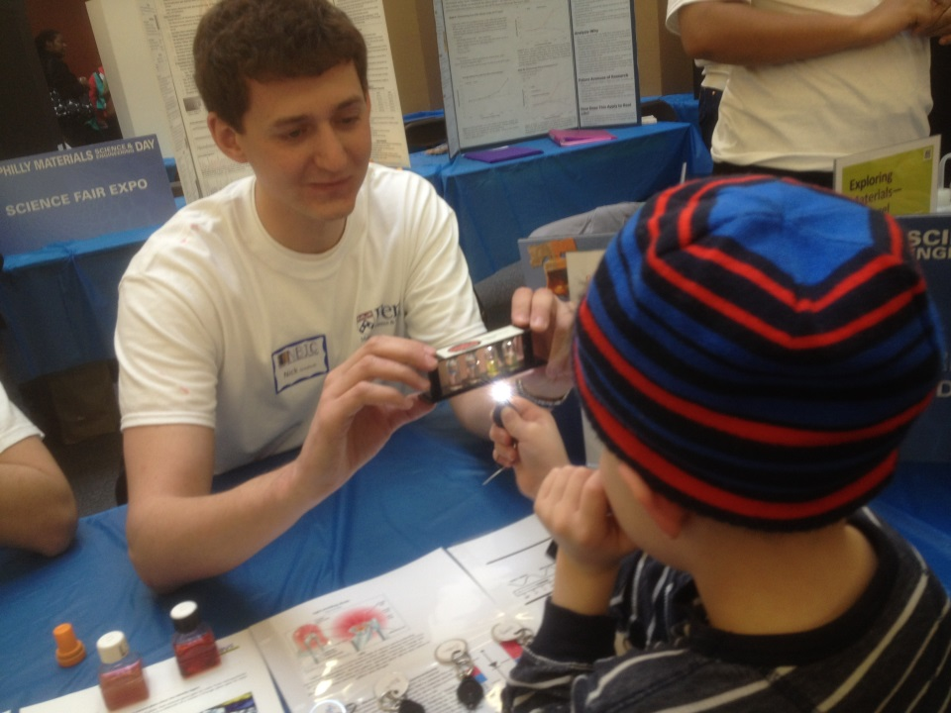
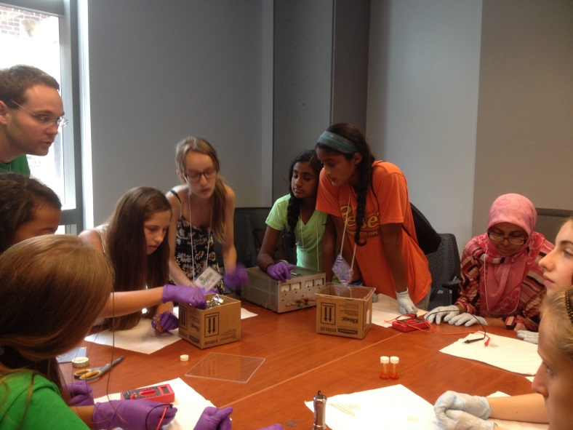
IRG-4 Broader Impacts
Technology: Increased nanophosphor upconversion efficiency may lead to improved photovoltaics, bioimaging, solid-state lighting and display technologies.
Education: Our team worked to stimulate interest in K-12 students through hands-on experiences.
Philly Materials Day, 2/2014.
IRG-4 student Nick Greybush demonstrated semiconductor and plasmonic nanocrystals
Girls in Engineering Math and Science (GEMS) Camp.
Kagan and members of her group, including IRG-4
student Nathaniel Berry (pictured), ran a hands-on
lab where girls fabricated LEDs
Support: Primary NSF MRSEC DMR-11-20901

