Slide 1
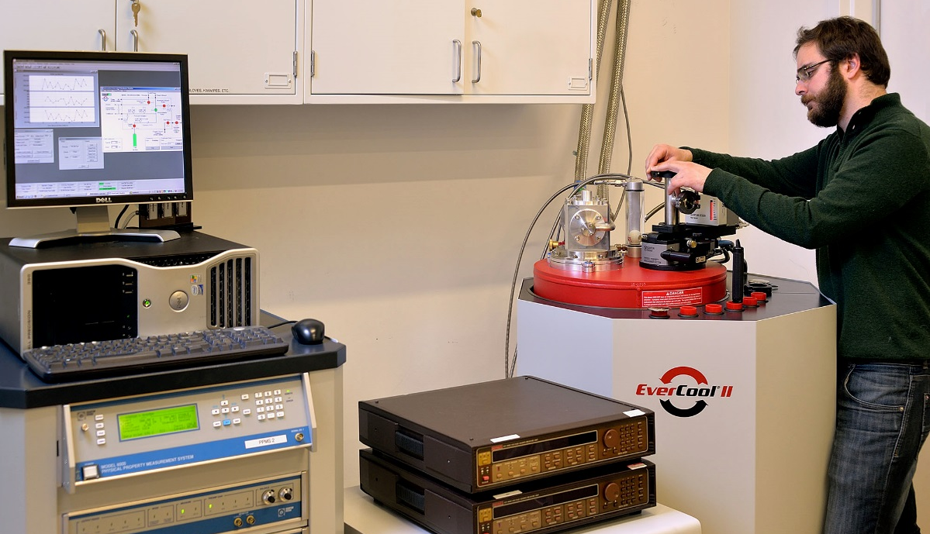
Helium Conservation in the Property Measurement Facility (SEF) J. M. Kikkawa
The NSF has awarded additional funds to support helium conservation in the Property Measurement Shared Experimental Facility (SEF). The SEF hosts over a dozen low temperature measurement capabilities requiring liquid helium. Using the award, the Property Measurement Facility added a helium re-liquefier to a cryogenic, superconducting magnet system. The new equipment nearly eliminates helium consumption in the facility, and will enable high levels of instrument availability for end-users. Helium is a vanishing resource on our planet that plays an important role in scientific discovery. This award will allow us to recapture helium rather than releasing it into our atmosphere and, ultimately, outer space.
Mehmet Noyan loads a sample into the helium re-liquefier.
Support: Primary NSF MRSEC DMR-11-20901
Notes:
Technical Explanation if needed

