Slide 1
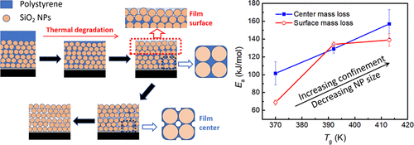
Thermal Degradation of Polymers under Extreme Nanoconfinement
DMR: 1720530
2020
H. Wang, Y. Qiang, A. A. Shamsabadi, P. Mazumder, K. T. Turner, D. Lee, Z. Fakhraai, University of Pennsylvania
A collaboration between members of IRG-1 (Fakhraai, Lee, Turner) explored the properties of disordered packings in different environments. Specifically, they investigated the effects of extreme confinement on the thermal properties of polymer-infiltrated nanoparticle films. The films are formed using capillary-rise infiltration (CaRI) method in which polymer (polystyrene [PS]) is infiltrated into a nanoparticle film to form highly confined disordered solids (top panel). Their results show that extreme nanoconfinement can significantly improve the thermal stability of PS and reduce its flammability. That is, spatial confinement enhancement the thermal stability of pure PS in ambient conditions. Experiments show that both the characteristic time of degradation, and the activation energy for degradation, increase with increasing degree of confinement, which has a strong correlation with the increased glass transition temperature (T_{g}) (bottom panel). Degradation starts from the film surface and centers of large voids, suggesting a diffusion-limited process. The group is now exploring the properties of these confined films as a function of interfacial interactions, polymer rigidity and molecular weight.
Wang, H., Qiang, Y., Shamsabadi, A. A., Mazumder, P., Turner, K. T., Lee, D., Fakhraai, Z.. Thermal Degradation of Polystyrene under Extreme Nanoconfinement. ACS Macro Letters 8, 1413-1418 (2019).
Notes:
[1] Wang, H., Qiang, Y., Shamsabadi, A. A., Mazumder, P., Turner, K. T., Lee, D., Fakhraai, Z.. Thermal Degradation of Polystyrene under Extreme Nanoconfinement. ACS Macro Letters 8, 1413-1418 (2019). https://doi.org/10.1021/acsmacrolett.9b00649

