Slide 1
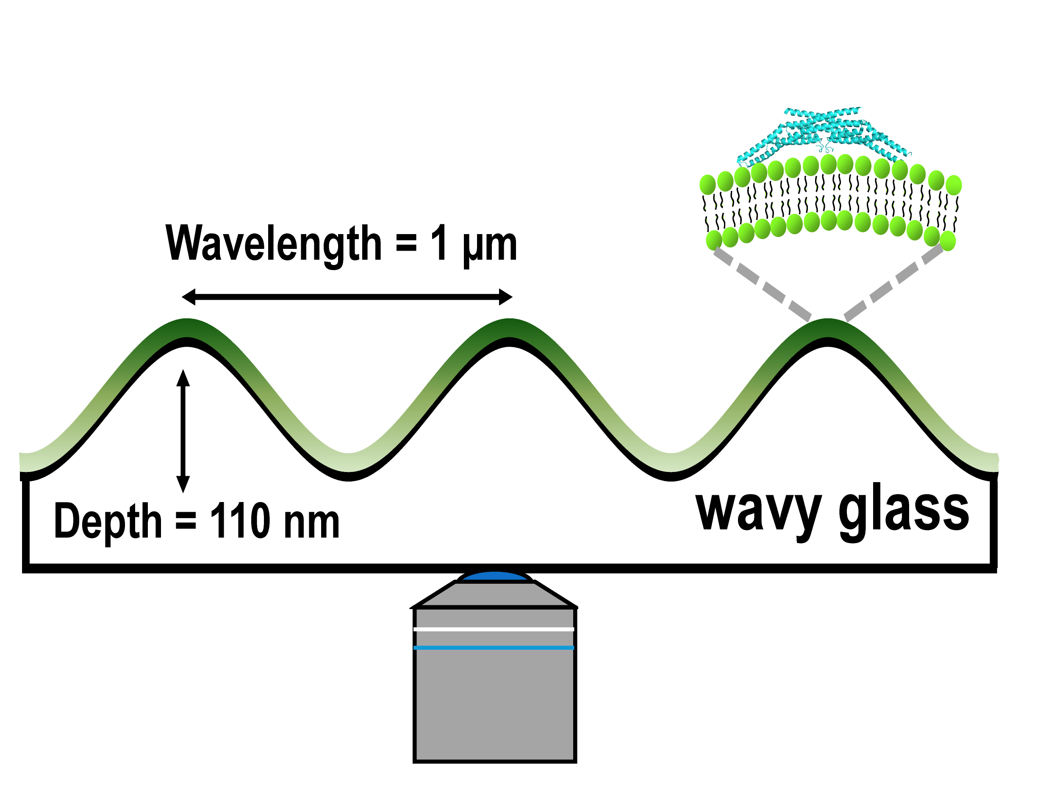
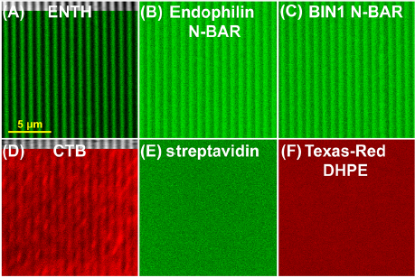
Curvature Sorting of Peripheral Proteins
on Solid-Supported Wavy Membranes
Tobias Baumgart and Shu Yang
The deformation of cell membranes couples with spatial distributions of membrane proteins and lipids. Current model membrane approaches studying curvature sensing are limited to positive curvatures and often involve complex setups. To overcome these challenges, solid- supported wavy membrane were fabricated by a combination of soft lithography and wet etching. We demonstrated that endocytotic proteins and the protein cholera toxin show curvature sorting on this engineered wavy membranes, whereas a control protein (streptavidin) showed no sorting.
Surface topography and curvatures measured via AFM
Langmuir, August 2012
Lipids and peripheral proteins on wavy membranes imaged via epi-fluorescence microscopy
Support: Primary/Partial NSF MRSEC DMR-11-20901
Notes:
Using a semi-fluorinated rod-like molecule that forms smectics A Planar anchoring at cylinder sides and at tops but frustrated at base of cell
(Kent state 2007 Nature Materials) 4’(5,5,6,6,7,7,8,8,9,9,10,10,11,-11,12,12,12-heptadecaflu-orododecyloxy)-biphenyl-4-carboxylic acid ethyl ester
In SmA phase: Forms a highly ordered triangular lattice of TFCDs with a lattice constant on the order of a few microns. DIMPLE; superhydrophobic properties
By confinement in micropost with square lattice— Homeotropic anchoring on post, planar at free surface: TFCDs adopt a square habit with the lattice constant of the microposts. At wide enough spacing, see 2 interpenetrating square lattices: reminiscent of laterally unconfined triangular lattice.
Scalloped microposts with gradient spacing on either side of micropost: can create splay between layers and step-defects at free surface- potentially interesting wetting properties
Apiradee's recent results show that we can change 1) TFCD symmetry (directed by the pillar's symmetry) and 2) TFCD periodicity (when using hexagonal array pillars with spacing less than the natural period of TFCD on flat surface)
2) here are additional two cartoons on TFCD assembly on pillars.
Path forward– seed 3D structures ‘epitaxially’ by pinning TFCDs on microposts in thicker LC layers

