Slide 1
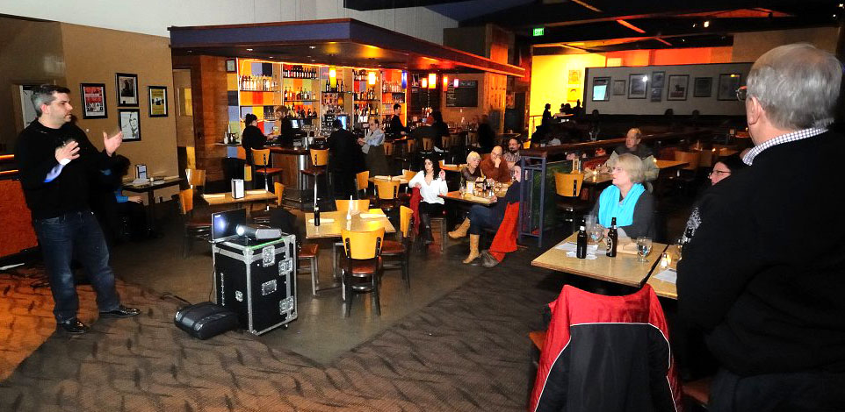
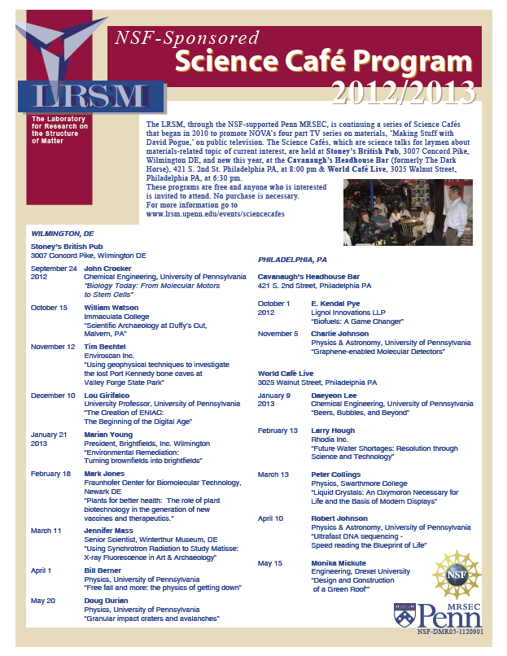


LRSM Science Cafés
Andrew R. McGhie, Mark Licurse, and Arjun G. Yodh
The LRSM Science Café’s inform the general public about materials-related scientific topics and their impact. They are arranged to take place in a convivial, bar/restaurant setting where people can congregate, have dinner or refreshments before a talk by an expert, and then have time to discuss the topic either during or after the talk. We host two Cafés every month during the school year; one in Wilmington, DE and one in Philadelphia, PA. Recent topics have included fuel cells, energy storage, carbon nanotube technology, solar energy, and liquid crystals displays (see 2012-13 flyer and photograph of talk at the World Café Live, Philadelphia). Most speakers have come from Penn. Attendance averages 40-50 people who come from all walks of life. To date, almost 40 Cafés have been held.
Larry Hough, Rhodia Inc.
“Future Water Shortages: Resolution through Science and Technology”
Support: Primary NSF MRSEC DMR-11-20901

