Slide 1
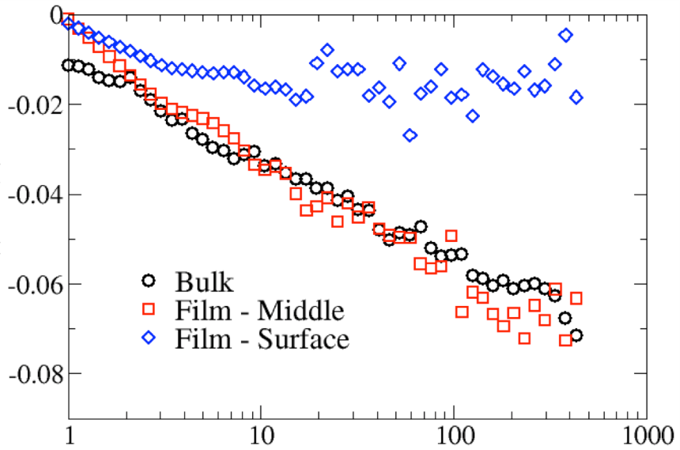
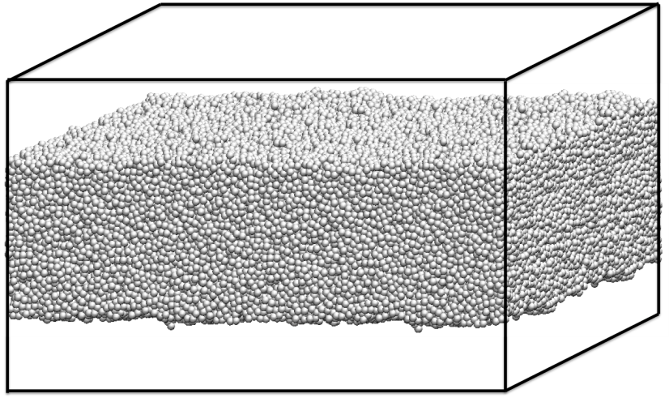
Physical Aging in Thin Polymer Films
Rob Riggleman, Zahra Fakhraai
Film surface
Internal Energy [ε]
Film middle
Aging Time [τ_{LJ}]
Using Monte Carlo and molecular dynamics simulations, we have investigated the dynamics of a model glass-forming polymer undergoing physical aging confined to a free-standing thin film. When a glass-forming material is cooled below its glass transition temperature Tg it falls out of equilibrium, and its physical properties (internal energy, dynamic properties) will gradually evolve towards their equilibrium values in a process known as physical aging. We have found that in free-standing thin films of polymer glasses, which have a Tg reduced from the bulk polymer, the free surface can rapidly reach equilibrium while material that is only approximately 10 nm from the surface exhibits a bulk-like equilibration process.
Support: Primary NSF MRSEC DMR-11-20901
Notes:
We have studied a coarse-grained polymer very similar to the canonical Kremer-Grest model, which consists of Lennard-Jones spheres connected by stiff harmonic bonds. To prepare our thin film samples, we began with bulk materials that were equilibrated with periodic boundary conditions (PBCs). We then compressed the simulation box in the z-direction until the length of the simulation box in that direction was approximately the desired film thickness and subsequently removed the periodic boundary conditions in the z-direction, creating two free surfaces. We then equilibrated our model polymer at temperatures far above the glass transition temperature Tg and performed rapid quenches to just below the bulk Tg, where our samples were held at constant T. Finally, we studied the time evolution of several material properties as our glasses underwent physical aging. Shown in the main figure is the internal energy of the bulk sample and the local internal energy resolved locally in our thin film samples. In the center of the film, we find a bulk-like aging process despite the fact that the average Tg of the film is reduced relative to the bulk. This bulk-like aging process coexists with a free-surface that rapidly reaches equilibrium, as demonstrated by the average internal energy no longer changing with increased aging time.

