Slide 1
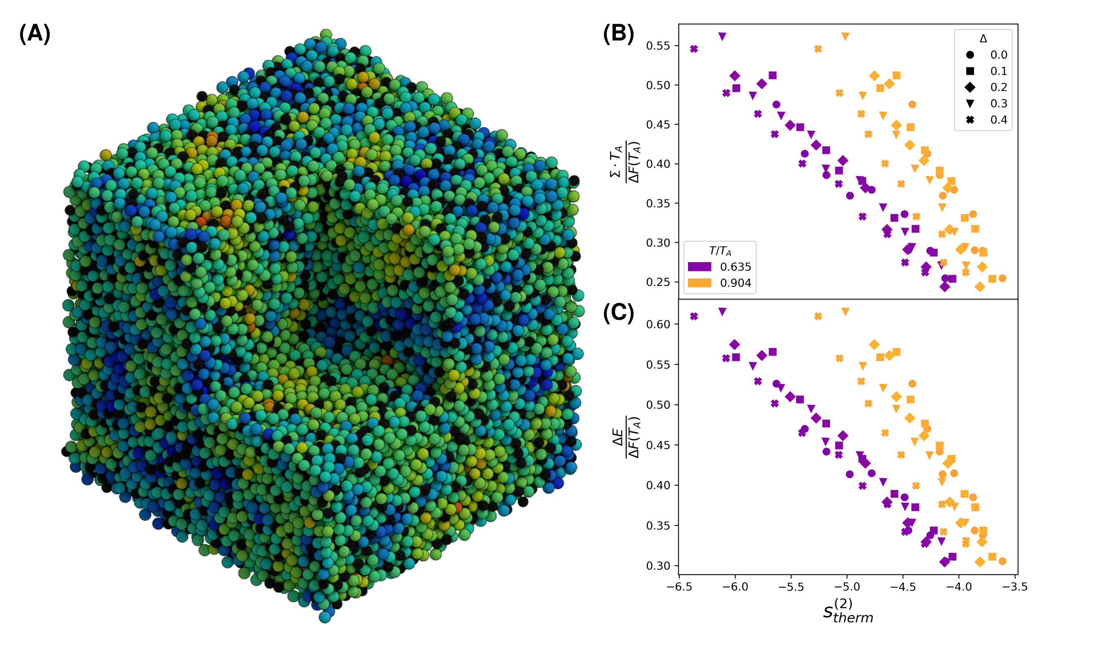
Penn MRSEC
DMR-1720530
Predicting the Softness of Glasses from Thermodynamics
Paulo Arratia and Robert Riggleman (University of Pennsylvania)
The properties of glasses – disordered, amorphous materials – can be hard to predict because of this lack of long-range order and the associate properties of crystal symmetry.
Work in this IRG has developed two fundamental descriptors to describe glass properties. The first of these – softness – is a machine-learning derived descriptor that characterizes structural defects in glasses and predicts rearrangements or yield that will occur in disordered materials in response to applied loads. The second – excess entropy – is a thermodynamic quantity that is a simple function of that describes the deviation of atomic arrangements from what would be predicated from ideal gas theory.
This study explored the relationship between these two parameters, in an effort to understand how fundamental thermodynamics via excess entropy can provide insight into a machine-learned, predictive descriptor, softness.
Numerical simulations showed that excess entropy can describe many of the same features as softness, providing a new framework to describe supercooled liquids such as glasses.
(A) Spatial distribution of particles with different machine-learned softness, strongly correlated with localized particle rearrangements within the glass. (B,C) Rearrangement barriers (entropic and energetic), rescaled to be dimensionless, against the ML-informed excess entropy of thermal configurations. Approximate collapse is observed in the data at the same temperatures relative to the onset of glassy dynamics. Agreement improves as one moves deeper into the supercooled regime.
Graham, I. R., Arratia, P. E. and Riggleman, R. A., Exploring the relationship between softness and excess entropy in glass-forming systems. Journal of Chemical Physics 158 (20), (2023) 10.1063/5.0143603
Notes:
What Has Been Achieved: The relationship between a machine-learned structural quantity (softness) and excess entropy in simulations of supercooled liquids has been explored. Excess entropy is known to scale well the dynamical properties of liquids, but this quasi-universal scaling is known to breakdown in supercooled and glassy regimes. Using numerical simulations, we test whether a local form of the excess entropy can lead to predictions similar to those made by softness, such as the strong correlation with particles’ tendency to rearrange. In addition, we explore leveraging softness to compute excess entropy in the traditional fashion over softness groupings. Our results show that the excess entropy computed over softness-binned groupings is correlated with activation barriers to rearrangement.
Importance of the Achievement: Machine-learning derived descriptors of the properties and response of materials such as softness have demonstrated impressive predictive power across multiple fields of materials science. But they do not provide a fundamental physical description. This study showed how excess entropy – a thermodynamic property - could be used to understand softness in a more fundamental way.
How is the achievement related to the IRG, and how does it help it achieve its goals? Softness and excess entropy have been among the fundamental properties explored in IRG1 of DMR-1720530. This study provides important new insights that link fundamental thermodynamics (via excess entropy) to a machine-learning based predictive descriptor (softness), and represent a culminating study of the IRG.
Where the findings are published: Graham, I. R., Arratia, P. E. and Riggleman, R. A., Exploring the relationship between softness and excess entropy in glass-forming systems. Journal of Chemical Physics 158 (20), (2023) 10.1063/5.0143603

