Slide 1
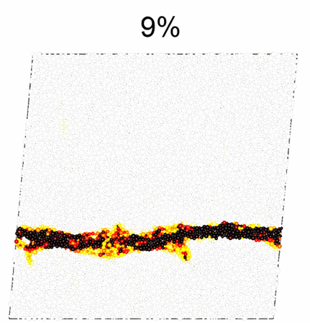
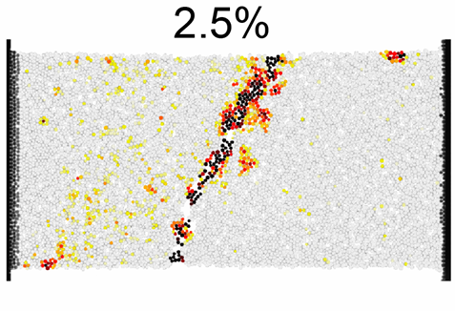
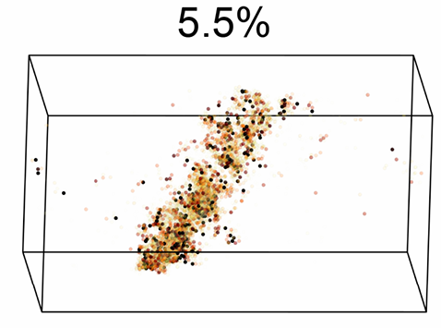
Penn MRSEC
DMR-1720530
Understanding Deformation in Disordered Materials
Robert Riggleman, Douglas Durian and Andrea Liu, University of Pennsylvania
Disordered particulate solids are ubiquitous in items ranging from plastic to concrete. Despite their prevalence, applications can be limited because they are often brittle. In contrast, ductile materials can be deformed smoothly and significantly without fracturing. Strategies for tuning ductility of disordered solids are empirical and system-specific.
Liu, Riggleman and Durian used computer simulations of atomic and polymeric glasses and laboratory experiments on granular packings to develop a general Structuro-Elasto-Plastic (StEP) framework for understanding large-scale deformation of disordered solids in terms of the system-specific interplay between local structure, local rearrangements and larger-scale elasticity.
The researchers first used known empirical strategies to tune each system to tune each system to exhibit different degrees of strain localization, which is the tendency for deformation to concentrate in specific areas rather than being evenly distributed throughout the material. Then they used a machine learning-based descriptor (‘softness’) as a key new quantity. All inputs to their model were independently measured and used to predict the stress-strain curves and the degrees of strain localization without adjustable fitting parameters.
This work could lead to quantitative approaches to designing disordered materials that are more resistant to fracture, a significant advance in materials science.
a)
b)
c)
Shear bands formation in different disordered solids are well-captured by our mesoscopic StEP model. From left to right: simulated atomic glasses (left), experimental granular packing (middle), and a simulated polymer glass (right). The particles are colored according to their local strain with darker red indicating higher strain, and the applied strain localizes in all three cases. The bottom row has the stress/strain response of the three systems measured in simulations or experiments compared to the StEP model for the same three systems, showing very good agreement.
Xiao, Hongyi, et al. "Identifying microscopic factors that influence ductility in disordered solids." Proceedings of the National Academy of Sciences 120.42 (2023): e2307552120.
Notes:
What Has Been Achieved: IRG researchers have developed a new model that allows them to understand how disordered solids, such as glasses and granular materials, deform under stress. They studied three different types of disordered solids and found ways to tune each system to exhibit different degrees of strain localization.
The researchers developed structuro-elastoplastic (StEP) models that reduce the complex behavior of the systems to a few key microscopic features that control strain localization. These models use a machine learning-based descriptor called "softness" to represent the stability of the local structure within the materials.
The StEP models revealed that the initial structure, the near-field effect of rearrangements on local structure, and rearrangement size were responsible for the changes in ductility observed in the three systems. This work provides a new theoretical framework for understanding how strain localization in disordered solids depends on the interplay between structure, plasticity, and elasticity.
Importance of the Achievement: Disordered solids are ubiquitous, with many useful mechanical, thermal, and optical properties, but differ in their responses to large deformations. While shaving cream is ductile, able to deform indefinitely, many disordered solids, such as window glass, are brittle. This limits applications. Empirical research has uncovered ways to improve ductility but offers little insight into their success or how to generalize to new materials. Here, we study three very different systems whose ductility is tuned differently. Previous theoretical approaches focused on interactions between plasticity with elasticity. To go further, we construct models that incorporate structure into this interplay. Our theory captures behaviors we observe experimentally and by computer simulations and yields insight into microscopic mechanisms underlying empirical strategies for tuning ductility.
How is the achievement related to the IRG, and how does it help it achieve its goals? Understs
Where the findings are published: Xiao, Hongyi, et al. "Identifying microscopic factors that influence ductility in disordered solids." Proceedings of the National Academy of Sciences 120.42 (2023): e2307552120.

