Slide 1
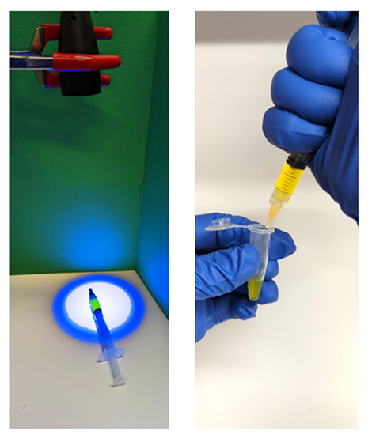
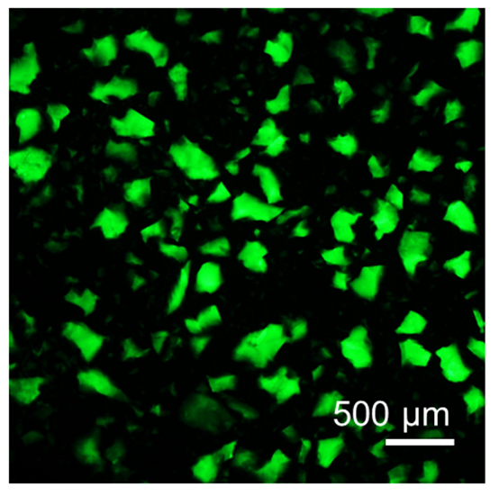
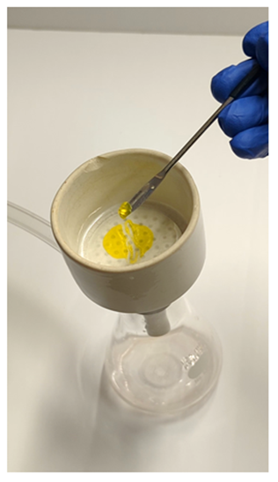
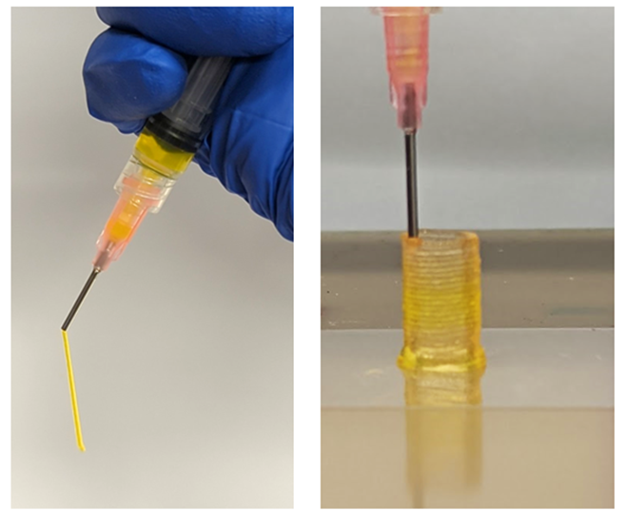
Univ. of Pennsylvania MRSEC
DMR-1720530
Fabricating Granular Hydrogels for 3D Printing
Paulo Arratia, University of Pennsylvania
Jason Burdick, University of Colorado
Granular hydrogels are jammed assemblies of hydrogel microparticles (i.e., “microgels”) widely explored in biomedical applications due to promising features such as shear-thinning to permit injectability and inherent porosity for cellular interactions. One area where this is particularly promising is in 3D printing.
To share this technology with others, we report a methods article on fabricating particles from photocrosslinked hydrogels, jamming the particles into extrudable solids, and then 3D printing the granular media into desired 3D structures (see figure) [1]. A great advantage to this platform technology is that hydrogel fragmentation was used to make particles, which allows for the processing of essentially any hydrogel into granular and printable formulations.
Using this technology, the Arratia and Burdick groups collaborated to fabricate granular hydrogels by mixing microparticles with complementary chemical groups that formed dynamic covalent bonds when in contact [2]. These chemical interactions altered the flow behavior of the granular media but still permitted 3D printing. Interestingly, the printed constructs were stable due to these chemical interactions, without any post-crosslinking needed.
Fragmentation of bulk hydrogels into microgels
Fragmented microgels in suspension
Fragmented granular hydrogel formation by vacuum-driven jamming
Extrusion and printing of fragmented granular hydrogels
[1] V.G. Muir, M.E. Prendergast, J.A. Burdick, Methods to Fragment Bulk Hydrogels and Process into Granular Hydrogels for Biomedical Applications, Journal of Visualized Experiments, 183:e63867, 2022.
[2} V.G. Muir, T.H. Qazi, S. Weintraub, B.O. Torres Maldonado, P.E. Arratia, J.A. Burdick, Sticking Together: Injectable Granular Hydrogels with Increased Functionality via Dynamic Covalent Inter-particle Crosslinking, Small, 18:2201115, 2022.
Notes:
What Has Been Achieved: Add your narrative here.
Importance of the Achievement: Add your narrative here.
How is the achievement related to the IRG, and how does it help it achieve its goals? Add your narrative here.
Where the findings are published: Enter citation and DOI here.

