Slide 1
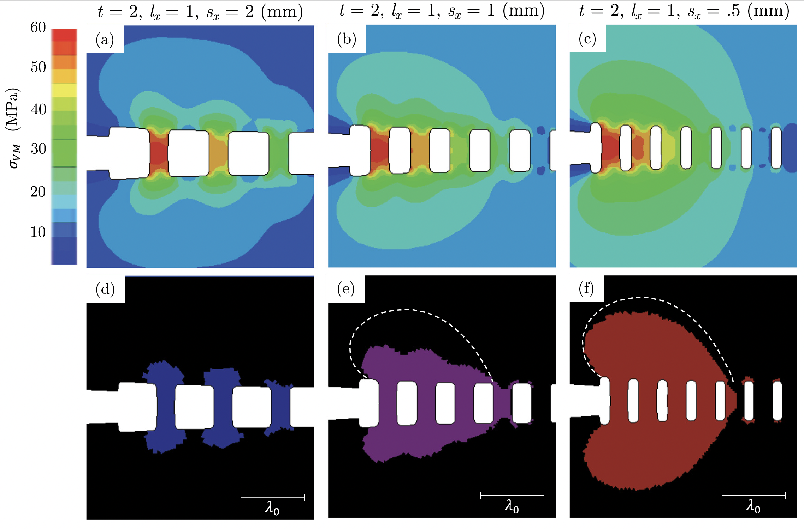
Penn MRSEC
DMR-2309043
Architecting Crack Tips to Enhance Fracture Toughness
Kevin Turner (University of Pennsylvania), Michal Budzic (Aarhus, Denmark)
One of the primary ways that materials fail in operation is by the formation and propagation of cracks during loading, often leading to sudden, catastrophic events.
The ability of a material to withstand fracture is described as its toughness. Over the years, researchers have developed a variety of way to enhance material toughness, thereby improving the ability of materials to withstand applied loads, but often at the cost of reducing overall strength
In this study, Penn MRSEC researcher Kevin Turner, and Michal Budzic of Aarhuas University in Denmark have shown that it is possible to control how a material can resist fracture by leveraging architecture, rather than by modifying material composition or microstructure as has been conventionally done.
They developed analytical models to predict the plastic zone geometry and resulting toughness enhancement for an elastic-plastic material containing a periodic array of pillars along the crack path, and optimized the size and placement of these pillars to achieve a remarkable 3.5 increase in fracture toughness without significant loss in strength.
Simulations showing how the height (t), length (l_{x}) and spacing (s_{x}) alter the stress (𝜎_{VM}) at a crack tip and thereby prevent crack propagation and increase toughness
Fulco, S., Budzik, M. K. and Turner, K. T., Enhancing toughness through geometric control of the process zone. JMPS,184, 14 (2024) 10.1016/j.jmps.2024.105548
Notes:
What Has Been Achieved: Material architecture provides an opportunity to alter and control the fracture process zone shape and volume by redistributing the local stresses at a crack tip. Properly designed structures can enlarge the plastic zone and enhance the effective toughness. Here, we use a pillar array as a model structure to demonstrate how variations in geometry at a crack tip control the size and shape of the plastic zone and can be used to engineer the effective toughness. Elastic–plastic finite element simulations are used to quantify how the pillar width, spacing, and height can be varied to tailor the size and shape of the plastic zone. A set of analytical mechanics models that accurately estimate the shape, volume, and resulting toughness as a function of the base material properties and geometry are also presented. A case study extends the analysis to sets of non-regular pillar arrays to illustrate how architecture can be used to alter toughness along the crack path.
Importance of the Achievement: This study developed a new method (architecting a crack front) and shown that that it is possible to enhance the fracture toughness of a material by >3.5 times without decreasing overall strength.
How is the achievement related to the IRG, and how does it help it achieve its goals? These results form a basis for the design of mechanical metamaterials. In future work, the ‘learning’ principles developed in the IRG can be used to train functional mechanical metamaterials via stiffness tuning of these bridges and self-learning.
Where the findings are published: Fulco, S., Budzik, M. K. and Turner, K. T., Enhancing toughness through geometric control of the process zone. Journal of the Mechanics and Physics of Solids 184, 14 (2024) 10.1016/j.jmps.2024.105548

