Slide 1
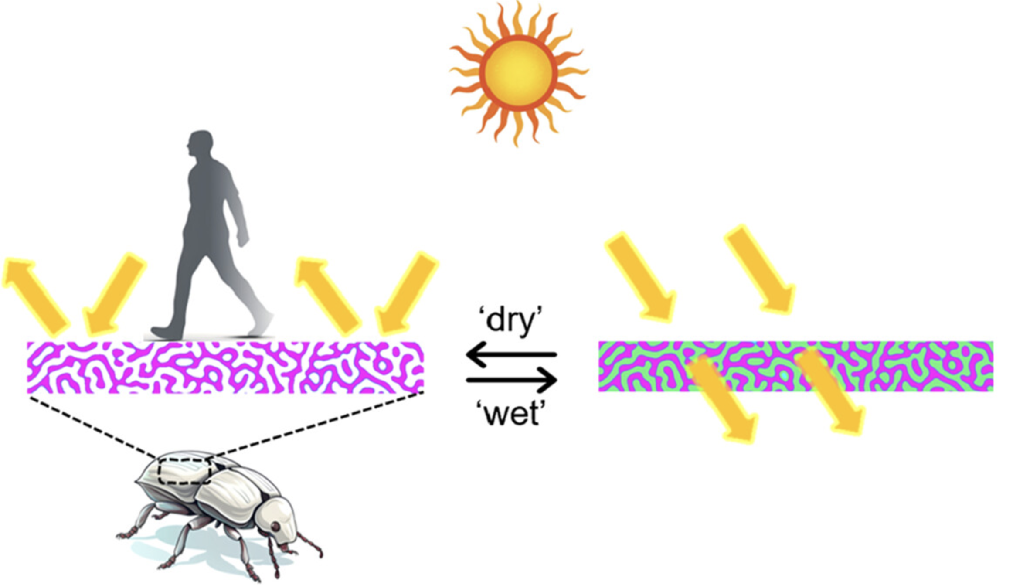
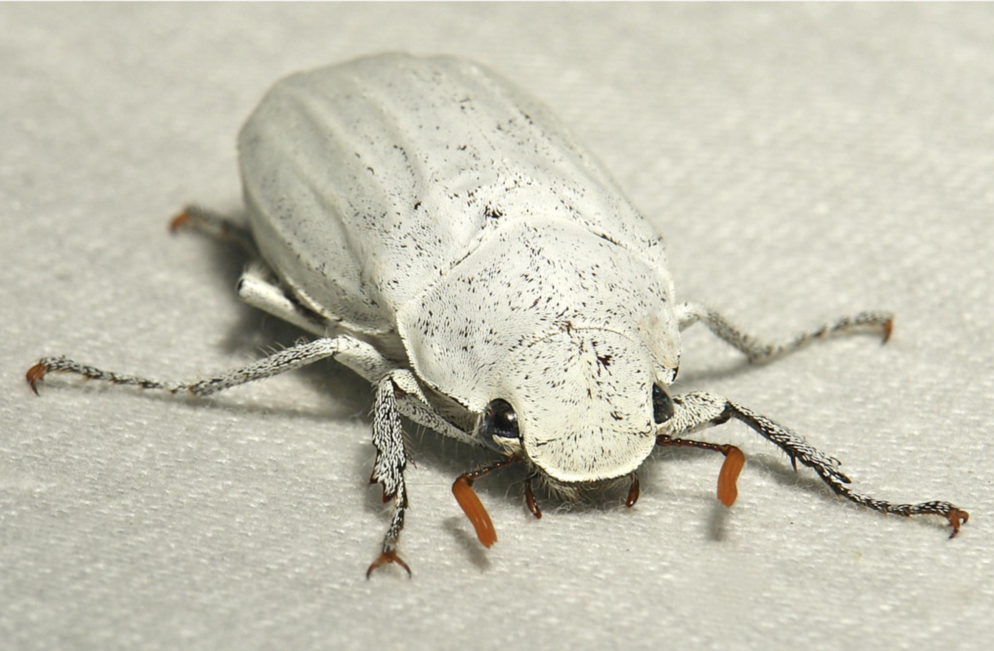
Penn MRSEC
DMR-2309043
Beetle Scales Inspire a Passive Daytime Radiative Cooling Coating
Kathleen Stebe and Daeyeon Lee, University of Pennsylvania
Passive daytime radiative cooling (PDRC) coatings provide an eco-friendly and cost-effective alternative to cool surfaces and structures. Ideally, these coatings would have excellent cooling performance in thin, mechanically robust layers that could switch from rejecting heat to accepting heat during periods of low sunlight and would be produced by low-cost and scalable methods.
Inspired by the structure of the Cyphochilus beetle, Stebe and Lee have developed a novel PDRC structure templated by bicontinuous, interfacially jammed emulsion gels (bijels) that possesses excellent cooling, thinness, tuneability, scalability, and mechanical robustness. These structures can be switched between two distinct states. They are bright white and extremely effective at radiating incident light back to space in the dry state, enabling cooling during warm seasons. However, when infused with a liquid, they become transparent, allowing incident light to penetrate and thus heat a structure during colder seasons.
The ability to switch between reflecting and transmitting solar radiation, along with their scalable fabrication and excellent cooling performance, makes these bijel PDRC coatings a promising alternative to traditional air conditioning, especially in underdeveloped regions with limited access to power infrastructure.
https://www.flickr.com/photos/itchydogimages/7254672494/
T. Wang, ACS Appl. Mater. Interfaces 2023, 15, 41, 48716–48724
Notes:
What Has Been Achieved: Passive daytime radiative cooling (PDRC) relies on simultaneous reflection of sunlight and radiation toward cold outer space. Current designs of PDRC coatings have demonstrated potential as eco-friendly alternatives to traditional electrical air conditioning (AC). While many features of PDRC have been individually optimized in different studies, for practical impact, it is essential for a system to demonstrate excellence in all essential aspects, like the materials that nature has created. We propose a bioinspired PDRC structure templated by bicontinuous interfacially jammed emulsion gels (bijels) that possesses excellent cooling, thinness, tunability, scalability, and mechanical robustness. The unique bicontinuous disordered structure captures key features of Cyphochilus beetle scales, enabling a thin (130 μm) bijel PDRC coating to achieve high solar reflectance (≳0.97) and high longwave-infrared (LWIR) emissivity (≳0.93), resulting in a subambient temperature drop of ∼5.6 °C under direct sunlight. We further demonstrate switchable cooling inspired by the exoskeleton of the Hercules beetle and mechanical robustness in analogy to spongy bone structures.
Importance of the Achievement: The IRG researchers have created a novel PDRC structure templated by bicontinuous, interfacially jammed emulsion gels (bijels) that possesses excellent cooling, thinness, tuneability, scalability, and mechanical robustness. These structures can be switched between two distinct states. They are bright white and extremely effective at radiating incident light back to space in the dry state, enabling cooling during warm seasons. However, when infused with a liquid, they become transparent, allowing incident light to penetrate and thus heat a structure during colder seasons. The ability to switch between reflecting and transmitting solar radiation, along with their scalable fabrication and excellent cooling performance, makes these bijel PDRC coatings a promising alternative to traditional air conditioning, especially in underdeveloped regions with limited access to power infrastructure.
How is the achievement related to the IRG, and how does it help it achieve its goals? The development and application of novel bijel systems is the explicit goal of IRG2, Theme IIB
Where the findings are published: Wang, Tiancheng, et al. "Bioinspired Switchable Passive Daytime Radiative Cooling Coatings." ACS Applied Materials & Interfaces 15.41 (2023): 48716-48724. https://doi.org/10.10 21/acsami.3c11338

