Slide 1
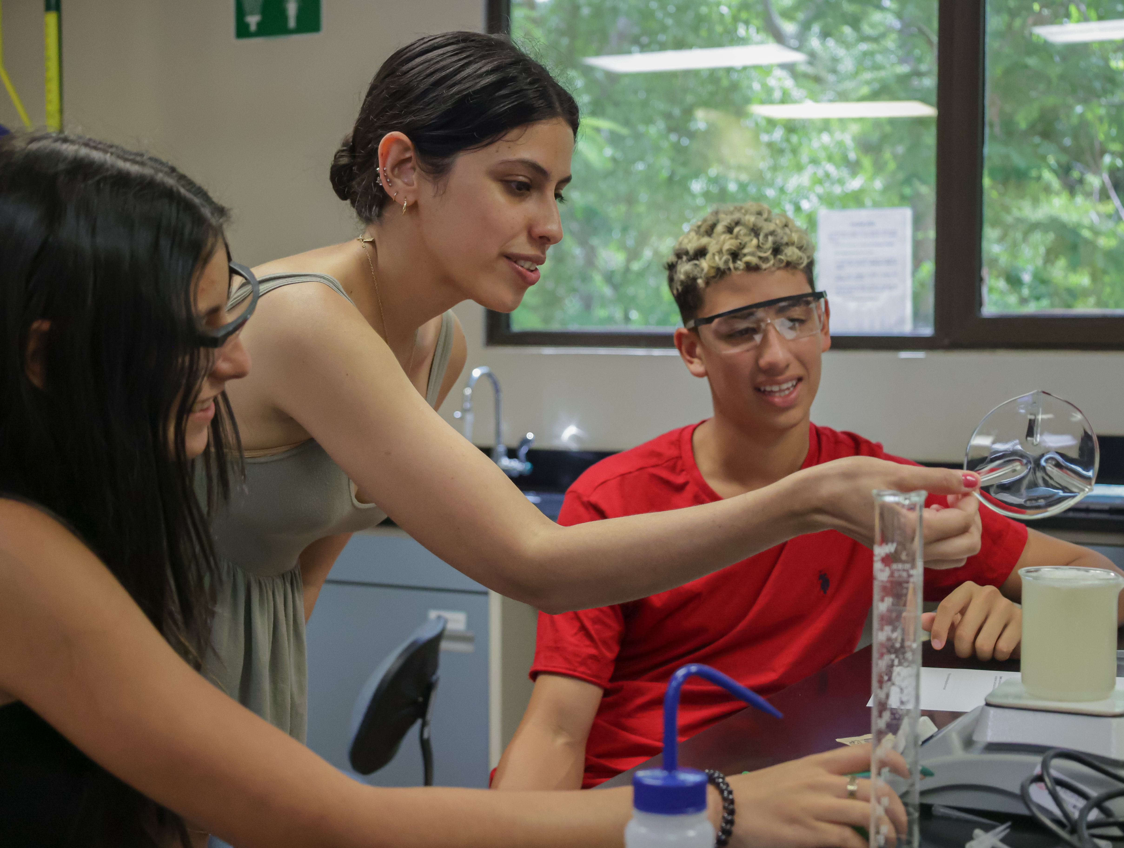

Penn MRSEC
DMR-2309043
Experimenta con PREM
Mark Licurse & Ashley Wallace, University of Pennsylvania
Experimenta con PREM is a two-week hands-on research program for high school students run annually at the University of Puerto Rico (UPR) Humacao & Cayey campuses. It remains a core program for the UPR-Penn PREM program with a history of attracting talented and motivated high school students to materials research; since its inception in 2005, 100% of students have graduated from high school and 78% pursue STEM after.
This year, 38 students (29 women, 100% URM) participated in the program from June 6-16 (2023). Penn graduate students Adriana Santiago-Ruiz (pictured in the photo - former Experimenta con PREM program participant and MRSEC REU student), and Karen Acosta, traveled to Puerto Rico to conduct workshops on Exploring Evolving Nanotechnologies.
MRSEC graduate student Adriana Santiago-Ruiz explaining the details of a hands-on experiment done during an "Exploring Evolving Nanotechnologies" workshop at Experimenta con PREM.
Notes:
What Has Been Achieved: Add your narrative here.
Importance of the Achievement: Add your narrative here.
How is the achievement related to the IRG, and how does it help it achieve its goals? Add your narrative here.
Where the findings are published: Enter citation and DOI here.

