Slide 1
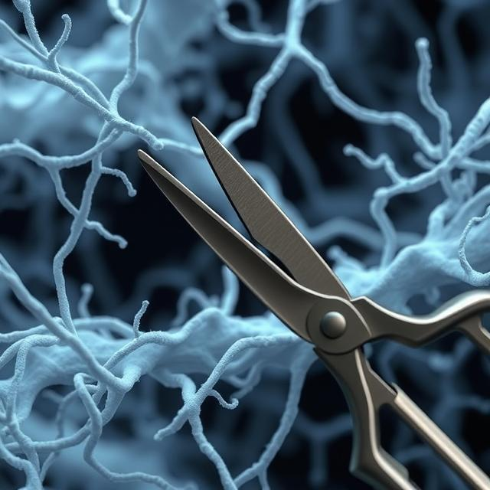
Penn MRSEC
DMR- 2309043
Building Rigid Networks with Prestress and Selective Pruning
John Crocker and Andrea Liu, University of Pennsylvania
Outcomes: Researchers John Crocker and Andrew Liu at the University of Pennsylvania have discovered that biopolymer networks pruned by tension-inhibited methods remain rigid at much lower coordinations than those pruned randomly. This finding helps explain the evolutionary advantage of tension-inhibited filament-severing proteins in biological systems.
Impact and Benefits: This research provides insights into the mechanics of biopolymer networks, such as the actomyosin cortex and collagen extracellular matrix, which are crucial for maintaining cellular and tissue rigidity under dynamic mechanical stresses. The results could lead to advancements in biomedical engineering and materials science, potentially benefiting medical treatments and the development of new materials.
Explanation: Biopolymer networks display high rigidity and tensile stress despite having coordinations below the normal threshold for mechanical rigidity. The study shows that networks pruned by tension-inhibited methods achieve cortex-like stiffness for biologically relevant tensile stresses and filament tensions, unlike randomly pruned networks. This selective pruning method leads to networks with significantly higher shear modulus and lower critical coordination, making them more efficient and robust.
Cunha, M. A. G., Crocker, J. C. and Liu, A. J., Building rigid networks with prestress and
selective pruning. Physical Review Research 6 (4), 6 (2024) 10.1103/PhysRevResearch.6.L042020
Notes:
What Has Been Achieved: IRG researchers successfully demonstrated that tension-inhibited pruning allows biopolymer networks to maintain rigidity at lower coordinations. By simulating networks under various prestrain conditions and pruning protocols, they showed that selectively pruned networks are stiffer and have a narrower filament tension distribution compared to randomly pruned networks. This achievement provides a mechanistic understanding of why tension-inhibited filament-severing proteins have evolved independently in different biological systems.
Importance of the Achievement: Understanding the mechanics of biopolymer networks and the role of tension-inhibited pruning has significant implications for both biology and materials science. This research sheds light on the fundamental principles governing cellular and tissue rigidity, which is essential for various physiological processes. Additionally, the findings could inspire the design of new materials with enhanced mechanical properties, potentially leading to innovations in biomedical engineering, such as improved tissue scaffolds and prosthetics. The ability to create rigid networks with lower coordination could also have applications in developing lightweight, strong materials for industrial use.
How is the achievement related to the IRG, and how does it help it achieve its goals? This research effort contributes to the IRG's goals by demonstrating how local adaptive rules, such as tension-inhibited pruning, can lead to robust and efficient mechanical properties in biopolymer networks. This mirrors the brain's ability to adapt and learn through local structural changes, providing a deeper understanding of adaptive learning mechanisms in both biological and artificial systems.
Where the findings are published: Cunha, M. A. G., Crocker, J. C. and Liu, A. J., Building rigid networks with prestress and
selective pruning. Physical Review Research 6 (4), 6 (2024)
10.1103/PhysRevResearch.6.L042020

