Slide 1
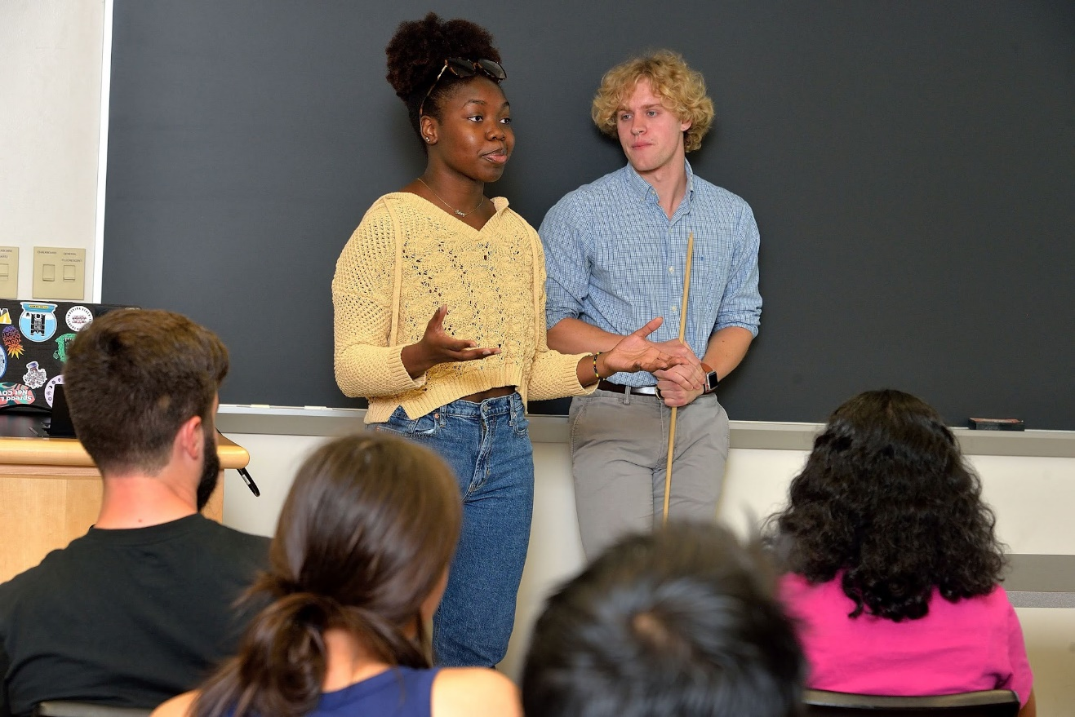
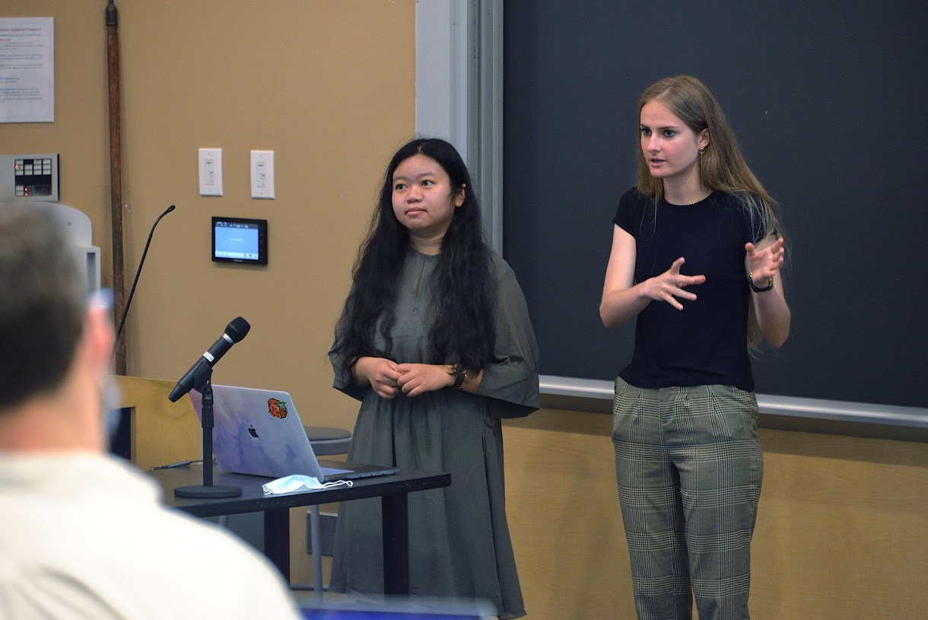
Penn MRSEC
DMR-2309043
REU: New Emphasis on Science Communication
Mark Licurse & Ashley Wallace, University of Pennsylvania
REU students presenting their research to a high school audience (right)
This program immerses students in hands-on materials research while incorporating a recently piloted initiative: training participants to become effective science communicators. While students spend 10 weeks conducting advanced research projects, they simultaneously develop crucial skills in translating complex scientific concepts for broader audiences, particularly younger students. The journey begins with an intensive science communication workshop, followed by weekly "chalk talks" where students progressively build presentations tailored for high school audiences. Throughout the summer, participants refine their communication techniques, culminating in final presentations to their peers and research groups, demonstrating both their scientific achievements and their ability to convey complex ideas clearly.
REU students presenting their research to fellow program participants and other research groups (left).
Notes:
What Has Been Achieved: Add your narrative here.
Importance of the Achievement: Add your narrative here.
How is the achievement related to the IRG, and how does it help it achieve its goals? Add your narrative here.
Where the findings are published: Enter citation and DOI here.

