Slide 1
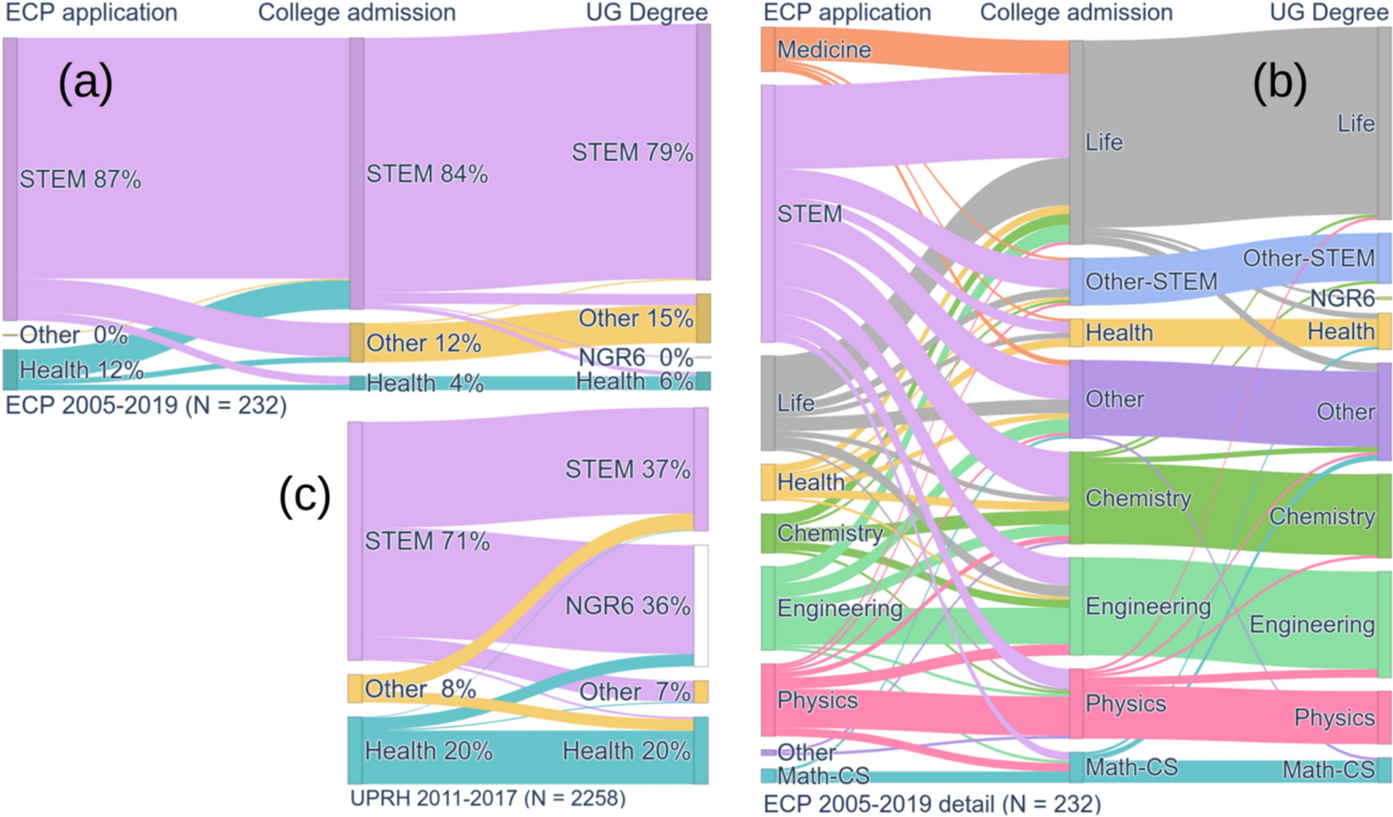
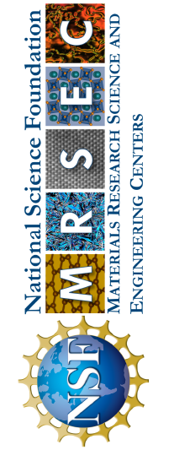
Penn MRSEC
DMR- 2309043
Experimenta Con PREM: Documenting Two Decades of Impact
Idalia Ramos, U. Puerto Rico, Humacao and Eric Stach, U. Pennsylvania
Outcomes: An article in the journal MRS Advances documented the outcomes of a summer research program for high school students based at the University of Puerto Rico, in partnership with the Penn MRSEC. Over the past two decades this program has engaged nearly 400 students in hands-on materials science research since 2005, with 84% pursuing STEM undergraduate studies.
Impact and Benefits: The program significantly increases STEM retention — with 79% earning STEM bachelor's degrees — more than double the rate of the comparison group at the same institution (37%).
Explanation: Experimenta con PREM provides early research experiences through a structured two-week immersion where students rotate through laboratories, engage in materials characterization, computational simulations, and device fabrication. Faculty mentors guide students through the entire research process, from literature review to presenting findings. The program showcases materials science as an interdisciplinary field and integrates families into students' STEM educational journeys.
Trajectories among Experimenta con PREM students and comparable cohort of UPRH students. A) Fields of study identified in ECP application, college admission, and bachelor’s degree graduation for ECP students who graduated or have been enrolled in a bachelor’s program (N = 232) for 6 years or more. b) Same data from (a), organized by specific fields of study. c) Fields of admission and graduation for UPRH students from freshman classes 2011–2017, enrolled in STEM or Health programs at some point during their studies (N = 2258)
I.Ramos, J.O. Sotero‑Esteva, V. Bansal, D. Barrionuevo, F. Bezares, E. Fasoli, M. Licurse, R. Oyola, N. Pinto, J. Santana, E.A. Stach, A. Wallace, MRS Advances, (2024) 9:1486–1493. https://doi.org/10.1557/s43580-024-00939-5
Notes:
What has been achieved
The Experimenta con PREM program has successfully created a pipeline for high school students to pursue STEM degrees and careers. Over two decades, the program has refined effective strategies to engage students in materials science research, demonstrating exceptional retention rates—79% of participants graduate with STEM degrees compared to only 37% in the comparison group.
Importance of the Achievement
This achievement directly addresses the national need to increase the STEM workforce by engaging students early in their academic careers. The program demonstrates how immersive research experiences can significantly influence career trajectories, particularly when tailored to showcase the interdisciplinary and collaborative nature of materials science. The program's success provides a replicable model for other institutions seeking to increase representation in STEM fields.
Relation to Research Goals
This achievement directly fulfills the primary goal stated in the LRSM Education and Human Resource Development plan "to attract more Americans to STEM fields and take them to the highest educational level possible, with emphasis on underrepresented minorities, women, and the disabled." The program
The program also supports the broader PREM collaboration between UPR and PENN, which aims to create pathways for student in materials research through a continuum from K-12 to STEM undergraduate programs and graduate school. By demonstrating quantifiable success in retaining students in STEM fields, Experimenta con PREM provides evidence that early research experiences can effectively address persistent gaps in STEM participation.
Where the findings are published: I. Ramos, J.O. Sotero‑Esteva, V. Bansal, D. Barrionuevo, F. Bezares, E. Fasoli, M. Licurse, R. Oyola, N. Pinto, J. Santana, E.A. Stach, A. Wallace, MRS Advances, (2024) 9:1486–1493. https://doi.org/10.1557/s43580-024-00939-5

