Slide 1
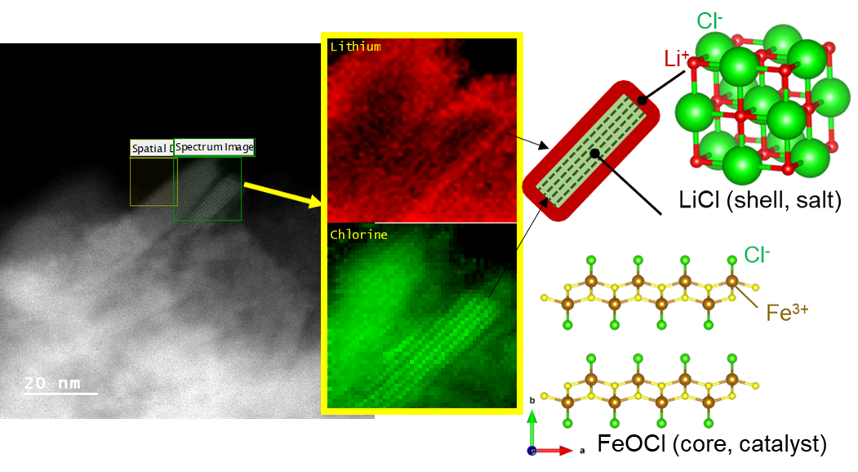
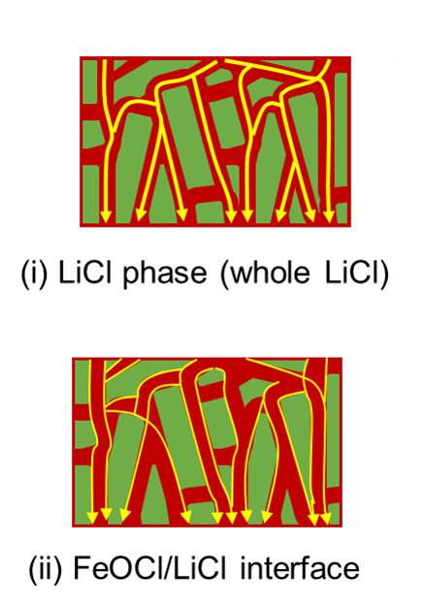
Penn MRSEC
DMR- 2309043
Fast Ionic Conduction Achieved Through Ceramic Heterointerface Design
User of Scientific Experimental Facilities: Toyota Research Institute of North America
Outcome: Toyota Research Institute of North America, collaborating with MRSEC-supported scientists and facilities have developed a novel [LiCl]/[FeOCl] heterointerface composite material (LFH) that achieves high lithium-ion conductivity from two traditionally non-conductive materials. The unique core-shell structure facilitates interstitial lithium-ion diffusion. Detailed structural analysis through transmission electron microscopy (TEM) and electron energy-loss spectroscopy (EELS) confirmed the core-shell architecture with lithium ions concentrated in the shell region.
Impact and Benefits: This breakthrough provides a new pathway for developing solid-state electrolytes with high ionic conductivity, chemical stability, and improved safety for next-generation batteries. The design concept extends beyond lithium systems to other energy storage applications. The approach could lead to superior ceramic electrolytes for electric vehicles, enabling batteries with higher energy density, longer cycle life, and reduced fire hazards compared to conventional liquid electrolytes.
Explanation The research team created a ceramic heterointerface by combining lithium chloride (LiCl) and iron oxychloride (FeOCl). Using advanced microscopy and spectroscopy, they revealed a core-shell structure where a crystalline FeOCl core is surrounded by an amorphous LiCl shell. The interface promotes interstitial lithium-ion diffusion with a low activation energy of 0.25 eV, comparable to advanced fast ion conductors. A prototype solid-state cell demonstrated 97% Coulombic efficiency, confirming the material's potential for practical energy storage applications.
A
Figure A: The unique LFH core-shell structure which facilitates interstitial lithium-ion diffusion as observed through TEM-EELS mapping. Interfacial lithium-ion diffusion (ii below) was confirmed over bulk diffusion (i below) via additional analysis techniques.
Shingo Ohta, et al.,, Fast ionic conduction achieved through the design and synthesis of ceramic heterointerfaces, Joule, 9 (2), 2025. doi.org/10.1016/j.joule.2024.11.006.
Notes:
What Has Been Achieved: Scientists have created a new class of ceramic electrolytes by engineering heterointerfaces between LiCl and FeOCl, two materials that are normally poor ionic conductors. The heterointerface promotes fast lithium-ion conduction with conductivities exceeding 1 mS/cm. The team confirmed lithium ions as the sole conductive species and demonstrated the material's functionality in a prototype solid-state battery.
Importance of the Achievement: Solid-state batteries with ceramic electrolytes are a key technology for safer, higher-energy-density energy storage, but have been limited by available materials. This research introduces a fundamentally new approach to designing ionic conductors by utilizing heterointerfaces to enable high concentrations of mobile interstitial ions. This strategy could be applied to other ion systems, including multivalent ions like Mg²⁺ and Zn²⁺, potentially enabling a diverse range of next-generation energy storage technologies beyond lithium-ion batteries.
How is the achievement related to the IRG, and how does it help it achieve its goals? While this is not related to the research conducted in the LRSM’s Interdisciplinary Research Groups, Toyota Research Institute of North America researchers utilized advance electron microscopy facilities supported by MRSEC funds.
Where the findings are published: Shingo Ohta, Nikhilendra Singh, Rajeev Kumar Rai, Hyeongjun Koh, Yihui Zhang, Wonjoon Suk, Max J. Palmer, Son-Jong Hwang, Michael Jones, Chuhong Wang, Chen Ling, Kimber Stamm Masias, Eli Stavitski, Jeff Sakamoto, Eric A. Stach, Fast ionic conduction achieved through the design and synthesis of ceramic heterointerfaces, Joule, Volume 9, Issue 2, 2025. doi.org/10.1016/j.joule.2024.11.006.

