Slide 1
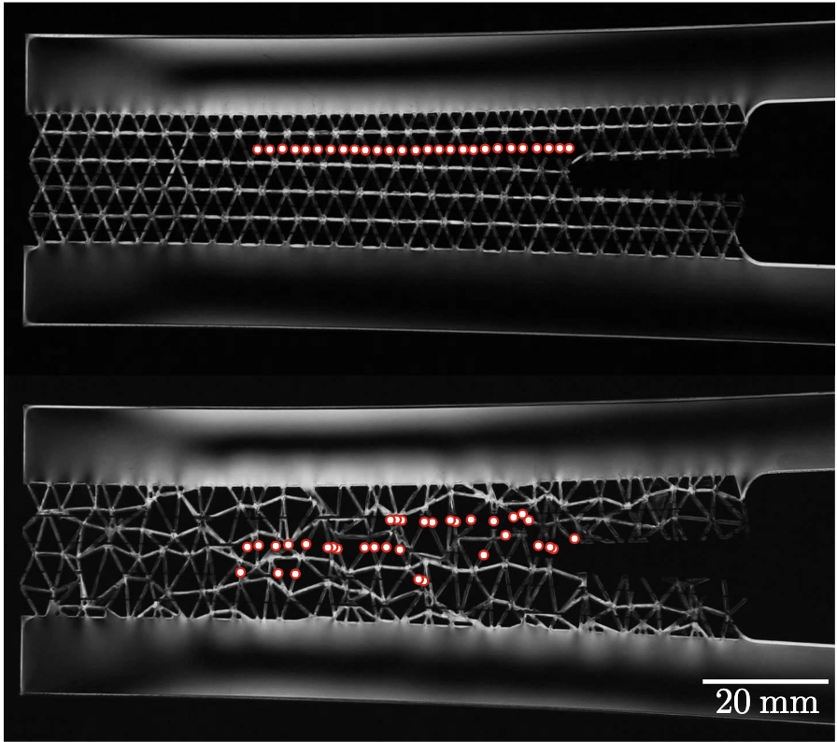
Penn MRSEC
DMR-2309043
Enhancing Fracture Toughness in Mechanical Metamaterials through Disorder
Kevin T. Turner and Doug Durian, U. Pennsylvania & Michal Budzik, Aarhus U.
Outcome: Researchers have demonstrated that introducing geometric disorder in mechanical metamaterials leads to distributed damage during failure, resulting in significantly enhanced fracture toughness with minimal loss of strength. This finding challenges the traditional reliance on periodic unit cell geometries in architected materials.
Impact and Benefits: This research provides a new approach to designing mechanical metamaterials with enhanced fracture toughness. The study opens possibilities for creating materials that are more damage-tolerant by leveraging disorder. These materials have various applications, including structural materials for aerospace and vehicles, protective gear, and biomedical devices.
Explanation: Geometric disorder was introduced into regular triangular lattices by perturbing nodal locations, and the impact on damage distribution and toughness was investigated. Improvements in toughness with increasing disorder, up to a limit, were observed in computational simulations and mechancis experiments. A mechanics-based scaling law that relates toughness to local changes in strength and the number of fracture events was shown to predict the changes in toughness with disorder.
In contrast to the structured design (top), the more disordered one (bottom) cracked less easily, as evidenced by the dispersion of fracture events (red dots). (Credit: Sage Fulco)
Fulco, S., Budzik, M. K., Xiao, H., Durian, D. J., & Turner, K. T. (2025). Disorder enhances the fracture toughness of 2D mechanical metamaterials. PNAS nexus, 4(2), pgaf023.
Notes:
What Has Been Achieved: The research team successfully demonstrated that disorder in metamaterials changes the damage path from a straight, continuous crack to discontinuous distributed damage, resulting in higher toughness. They identified an optimal level of disorder where toughness is maximized, achieving more than 2.6 times the toughness of an ordered lattice of equivalent density. These results were verified through simulations and experiments.
Importance of the Achievement: Understanding how disorder enhances fracture toughness has significant implications for the design of mechanical metamaterials. This research challenges the conventional focus on periodic structures and highlights the potential of disordered architectures to achieve superior mechanical performance. The findings could lead to the development of more resilient materials for various applications, enhancing safety and durability.
How is the achievement related to the IRG, and how does it help it achieve its goals? This paper contributes to the IRG's goals by demonstrating that local pertubations of mechanical networks (i.e. mechanical metamaterials) can significantly improve their mechanical properties, illustrating the potential for achieving improved performance through local tuning. Nature often relies on disordered structures to achieve specific function and properties, yet few engineered mechanical metamaterials exploit disorder. This is in part due to the challenge of designing disordered systems, which have may degrees of freedoms. Our current work in the MRSEC aims to exploit local learning rules for efficient design of resilient materials.
Where the findings are published: Fulco, S., Budzik, M. K., Xiao, H., Durian, D. J., & Turner, K. T. (2025). Disorder enhances the fracture toughness of 2D mechanical metamaterials. PNAS nexus, 4(2), pgaf023.

