Slide 1
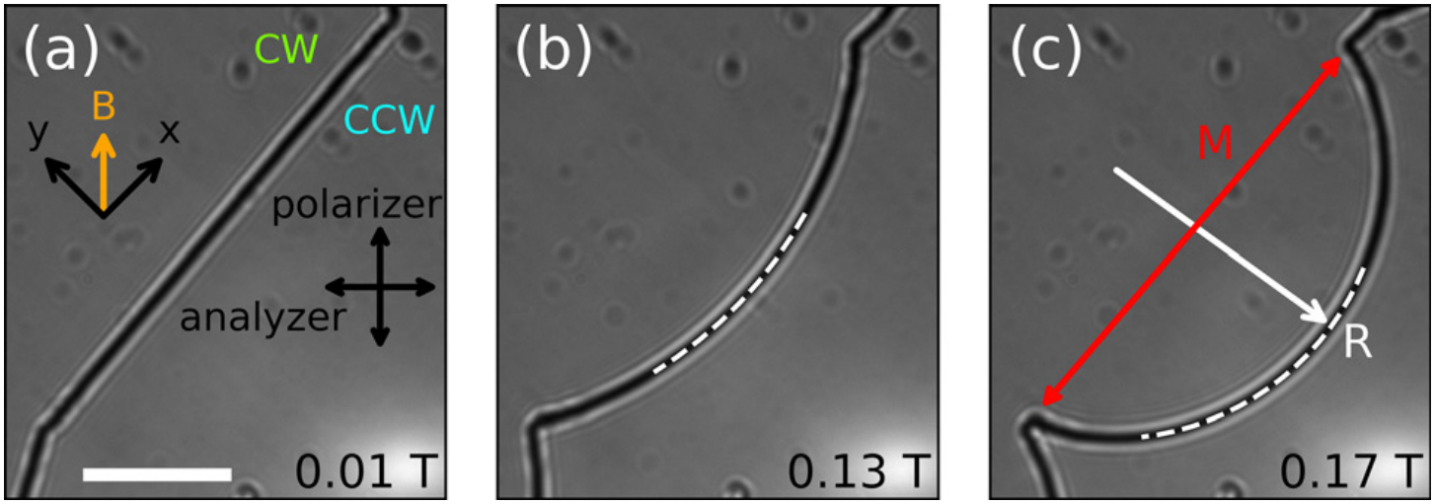
Penn MRSEC
DMR- 2309043
Measuring the Line Tension of Liquid Crystal Defects
Arjun Yodh, Jay Kikkawa, University of Pennsylvania; Peter Collings, Swarthmore
Outcome: Researchers at the University of Pennsylvania and Swarthmore College developed new non-invasive methods to measure the mechanical properties of defects in liquid crystals using magnetic fields and advanced imaging. The study revealed that the line tension of twist disclinations ranges from 75 to 200 piconewtons and increases logarithmically with sample thickness, providing crucial quantitative data for testing theoretical models of these defects.
Impact and Benefits: The work provides fundamental insights into the behavior of topological defects, which could be useful for materials science and potential technologies from displays to soft robotics. The ability to precisely measure and control defects in liquid crystals enables development of programmable soft materials that can respond to external stimuli in controlled, predictable ways.
A free disclination imaged between cross polarizers at various strengths of the magnetic field indicated by the labels. Sample cell thickness is 15.9 μm. The dashed arcs are part of the best fit to the disclinations. Only part of the fit is shown for clarity. Scale bar in (a) is 500 μm and is the same for the other two images.
Explanation: Disclinations are line-shaped defects that arise in liquid crystals and other materials. Using confocal microscopy and magnetic fields, researchers characterized their three-dimensional shape and measured their line tension by deforming their shape. Specifically, the disclinations in twisted liquid crystal cells form curved patterns that bend into circular arcs in strong magnetic fields. By comparing observed disclination contours to theoretical models, the researchers determined the mechanical and morphological properties of single disclinations—crucial information for designing new soft materials with unique responses to external stimuli.
Chen, Y. H., Mandic, M., Slaughter, C. G., Tanaka, M., Kikkawa, J. M., Collings, P. J. and Yodh, A. G., Morphology and line tension of twist disclinations in a nematic liquid crystal. Soft Matter 20 (45), 9050-9059 (2024) 10.1039/d4sm01076k
Notes:
What Has Been Achieved: This research introduced two non-invasive techniques to study liquid crystal defects: 3D confocal microscopy imaging and magnetic field manipulation. These methods allowed precise measurements of disclination line tension (75-200 piconewtons) and established a lower bound for the defect core size (approximately 32 nanometers). The study confirmed theoretical predictions that disclination tension increases logarithmically with sample thickness.
Importance of the Achievement: Understanding the mechanical properties of liquid crystal defects is essential for developing novel materials with unique responses to external fields. This fundamental research bridges theoretical predictions and experimental observations, helping resolve discrepancies between them. The non-invasive methods developed here can be extended to study other defects in liquid crystals and similar materials, opening pathways to new technologies in soft robotics, responsive materials, and advanced display technologies.
How is the achievement related to the IRG, and how does it help it achieve its goals? This work on liquid crystal disclinations directly supports the broader research goals of understanding mesoscale order in condensed phases of biological materials. The methodologies developed to study the structure, dynamics, and transitions in synthetic liquid crystals provide a foundation for investigating similar phenomena in cellular biomaterials. By mastering the measurement and control of defects in simpler liquid crystal systems, we have gained crucial tools and insights applicable to the more complex isotropic-to-anisotropic transitions observed in cellular condensates and protein polymers. This achievement represents a key stepping stone toward engineering synthetic disordered peptides with programmable shape transitions across multiple length scales.
Where the findings are published: Chen, Y. H., Mandic, M., Slaughter, C. G., Tanaka, M., Kikkawa, J. M., Collings, P. J. and Yodh, A. G., Morphology and line tension of twist disclinations in a nematic liquid crystal. Soft Matter 20 (45), 9050-9059 (2024) 10.1039/d4sm01076k

